Slide 1
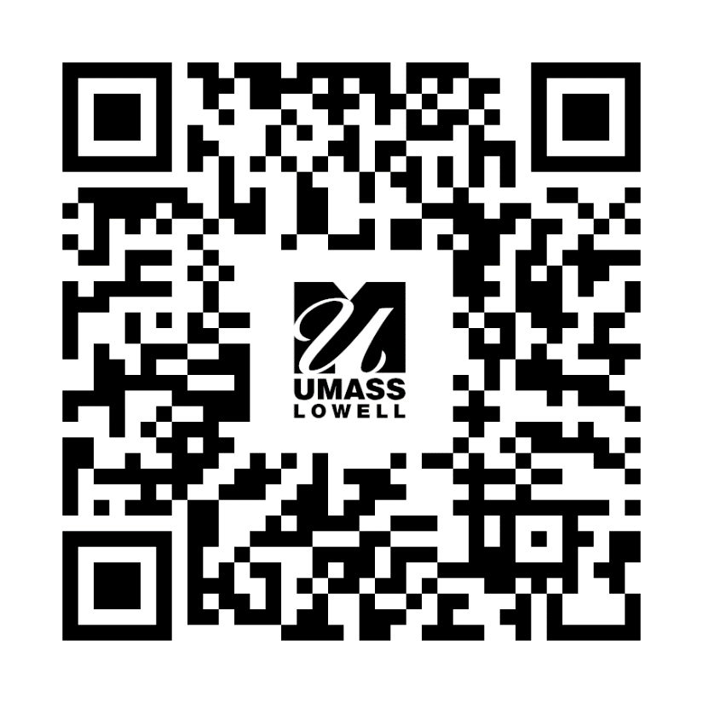
Tutoring at UMass Lowell
Free Drop-in Tutoring
Centers for Learning, Advising & Student Success (CLASS):
Locations on North, South, & East
Hours include evenings
Available Monday-Friday & Sunday
All hours listed on Searchable Schedule
Includes core subjects for all majors & much more
Some remote tutoring available
Departmental tutoring:
Centralized tutoring within respective academic buildings
Includes Math, Biology, Chemistry, Organic Chemistry, Physics, Environmental Science, & Health Sciences
Most are on the Searchable Schedule
Mix it up! Choose tutoring based on location and time. What fits your schedule? Explore tutors from both CLASS and your department to see who you work best with.
Questions? Email: Tutoring@uml.edu
Searchable Schedule

