Slide 1
Umass Lowell
Promotion & Tenure REVIEWER PREPARATION
September 23, 2026

Slide 2
Before we begin
This slide deck and additional materials designed to help your committee will be shared with you after this meeting.
The P&T Website offers a great deal of information!
Visit www.uml.edu/pandt.
For procedural questions, contact pandt@uml.edu.

Slide 3
IMPORTANT REMINDER
The Provost’s guidelines provide recommendations to the candidate developing a portfolio for promotion and tenure on ways to present their accomplishments effectively and concisely. They were developed to promote consistency in the organization of the candidate’s materials, to provide the candidate with an understanding of what reviewers look for, and to provide clarity to readers at various levels of review.
Neither the guidelines nor today’s discussion supersede, replace the language of the MSP contract, or reflect a comprehensive statement of MSP contract principles. The faculty candidate, members of personnel committees, and chairs are expected to review the relevant sections of the MSP contract.

Slide 4
Thank you for serving
The granting of tenure is the single most important personnel decision made by the University. Tenure, once attained, shall confer upon the individual the right to hold their position and not to be removed there from except as provided through due process and for just cause. Barring unforeseen circumstances, tenure obligates the University to the employment of an individual for the balance of their professional life.

Slide 5
Professionalism in the process
Faculty who serve on review committees are obliged to fully inform themselves concerning the credentials and qualifications of candidates.
The promotion and tenure process is a confidential personnel matter. No reviewer should discuss or disclose proceedings of committee meetings or documents associated with the process outside the appropriate convenings.

Slide 6
RECENT Updates
University Rank and Tenure (URT) Committee now includes a full teaching/clinical faculty representative. This representative will vote on cases of teaching/clinical faculty only. The representative will be elected by MSP.
Prior to being forwarded to pandt@uml.edu by the established deadline, DPC letters must be reviewed by the Chair, and CPC letters must be reviewed by the Dean. In the case of a candidate who is a Chair, the DPC letter must be reviewed by the Dean prior to being sent.
More details on this “pre-submission check” later in this presentation!
Optional COVID tenure delay continues for faculty hired before September, 2021.
Notes:
Downloading Guidelines.
DocuSign will reach P&T email

Slide 7
Important dates
Review level | Access to file share begins | Candidate responses (to previous level) due | Committee meets | Review letters due NOTE: Chair or Dean Review to be completed prior to this date.
DPC | 10/05/26 | N/A | Committee determined | 10/26/26
Chairs | 9/15/26 | 11/2/26 | N/A | 11/09/26
CPC | 11/09/26 | 11/16/26 | Committee determined | 12/07/26
Deans | 12/7/26 | 12/14/26 | N/A | 1/11/27
URT | 01/11/27 | 01/19/27 | 02/04/27 & 02/05/27 | 02/16/27

Slide 8
Membership voting
Committee members can vote at rank or below.
  Only Full Professors (both tenure or teaching/clinical track) vote on cases of faculty seeking promotion to Full Teaching or Full Clinical Professor.
A rank-eligible teaching or clinical faculty member must be present to vote on teaching- or clinical-track candidates – this has been extended to include URT.
One person – one vote.
  Chairs do not serve on DPCs for matters of promotion & tenure.
  CPC members will recuse themselves from votes for faculty members from their own department.
  URT members will recuse themselves from votes for faculty members from their own college; the Provost convenes but does not vote at URT.
Notes:
Donna

Slide 9
committee Practices
DPC and CPC meetings should be held in person.
CPC members will present faculty candidates from their own department in order to carry forward insights from the DPC discussion, but will not participate in the vote.
Similarly, URT members will present faculty candidates from their own college but will not participate in the vote.
Committee members not present for the discussion may not participate in the vote.
Committee chairs should plan the order of review and provide a brief break between candidate ranks to allow non-eligible members to make their exit.
Each committee should determine meeting protocols in advance—more in a moment on meeting protocols.
Notes:
Donna

Slide 10
CRITERIA FOR EVALUATION

Slide 11
Criteria for promotion to associate teaching/clinical professor
In considering a candidate for promotion to Associate Teaching Professor or Associate Clinical Professor, the criteria for promotion are:
excellence in teaching and excellence in service
Notes:
Donna

Slide 12
Criteria for Promotion to
Full TEACHING/CLINICAL Professor
Criteria for consideration of a candidate for promotion to Full Teaching/Clinical Professor, as differentiated from promotion to Associate Teaching/Clinical Professor:
The criteria for promotion are excellence in teaching and excellence in service.
The candidate should demonstrate growth in leadership in matters of pedagogy and in service, particularly in relation to teaching and learning.
Notes:
Donna

Slide 13
Criteria for tenure and promotion to associate professor
Consideration of a candidate for tenure shall be based on the following:
Convincing evidence of excellence in research, creative or professional activity and teaching and strength in service such as to demonstrate the possession of qualities appropriate to a member of the faculty occupying a permanent position.
Reasonable assurance of continuing development and achievement leading to further contributions to the University.
Notes:
Donna

Slide 14
Criteria for Promotion to Full Professor
Criteria for consideration of a candidate for promotion to Full Professor, as differentiated from promotion to Associate:
A continued record of accomplishments for research/scholarship,
Long-term, successful teaching
Most importantly, wide recognition by learned societies or professional associations for demonstrated achievement of leadership in the discipline or professional area.
Sustained levels of achievement in research and teaching, and demonstrated leadership in service.

Slide 15
Voting SPECIFICATIONS
Promotion to Associate Professor with tenure and cases of tenure only:
  Separate votes for research, teaching, and service
  Requirement: excellence in research and teaching, strength in service
  Candidates must meet each of those requirements to be recommended
Promotion to Full Professor:
  Holistic vote -- recommend or do not recommend
Promotion for Teaching and Clinical faculty (either to Associate or to Full):
  Separate votes for teaching and service
  Requirement: excellence in teaching and service
  Candidates must meet each of those requirements to be recommended
Notes:
Copy of Sample Ballots to Joe Hartman

Slide 16
GUIDANCE FOR NEGATIVE AND NON-UNANIMOUS VOTES
When any negative vote is made, even in one area when multiple criteria are evaluated, and even if the overall letter is a positive recommendation, the letter must include the rationale for that vote based on the criterion.
If a negative vote reflects concerns raised during discussion, the letter should explain what those concerns were and how they relate to the P&T criteria.
If the discussion did not include reasoning for a negative vote, but a negative vote is present, the committee should discuss the case again to surface any concerns. (This is the responsibility of all members, not only minority opinion-holders.)
The letter must explain the reasoning and criteria (positive and negative, majority and minority) that informed the committee’s votes. It should provide sufficient detail to allow the candidate to respond, and to ensure that later reviewers will understand how the committee reached its decision.

Slide 17
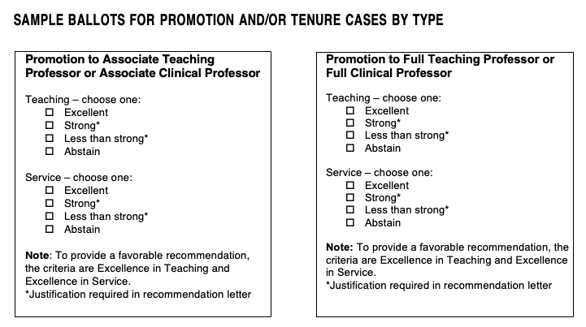
Sample ballots

Slide 18
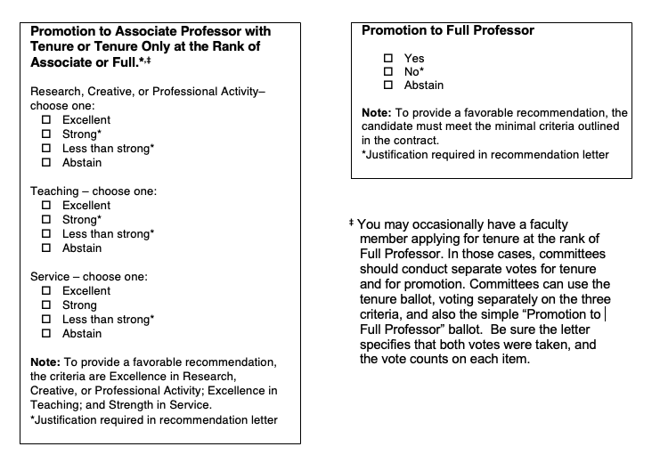
Promotion to associate

Slide 19

Recommended
Personnel Committee Protocol*
Increasing transparency & equity in personnel decisions
* Note: These are guidelines based on best practices; they are not required.

Slide 20
Recognizing implicit bias
Implicit bias refers to the attitudes or stereotypes that affect our understanding, actions, and decisions in an unconscious manner.
These biases are not explicitly expressed or consciously held, which makes them different from explicit biases that are consciously held and expressed.
Implicit bias can influence our perceptions, judgments, and behaviors in subtle ways, often without us being aware of it.

Slide 21
Effects of implicit bias
Implicit bias can influence various aspects of decision-making, including hiring, promotions, academic evaluations, and resource allocation.
When unchecked, bias can lead to disparities in opportunities and outcomes for different individuals or groups and compromise meritocracy
Implicit bias poses a challenge to efforts aimed at promoting diversity and inclusion and hinder initiatives to make meaningful and lasting change.

Slide 22
Bias proliferates when …
Establish a Protocol to Mitigate Bias
Process is ambiguous
Appraisal is hasty rather than deliberative
Accountability is lacking
See Heilman & Haynes, 2004 for review

Slide 23
Act together to promote equity
Reduce ambiguity → discuss the evaluation criteria
Enhance appraisal procedure → follow reflective steps
Increase accountability → ask individuals (and require
committees) to articulate reasoning

Slide 24
Recommended Process for Personnel Committees
Before the meeting → Preparation
During the meeting→ Decision Making Process
After the meeting → Committee Letter

Slide 25
I. Before the meeting→ PREPARATION
• Review all materials carefully
  Individually review materials/dossier – taking notes as you read can be very helpful in discussions
• Form your own initial assessment
  Determine your initial assessment (without others’ influence) for each element of the vote on the relevant ballot
  Identify the specific evidence that supports your assessment
  • Committee chairs are urged to communicate with members prior to the meeting about the planned meeting protocol and review voting eligibility for specific candidates as needed.

Slide 26

during he meeting
II. During the meeting → DECISION MAKING PROCESS
Set the tone:
Remind members about confidentiality
Preview the plan for the meeting
Guide the process: start with a new
person for each round
Step 1: One-word assessment
for the first criterion
Remind the group that their
initial ratings are non-binding
and are not recorded.
- Each voting member shares their
one-word, initial assessment about
the first relevant criterion.
I think this candidate’s research is…
Excellent
Excellent
Less than Strong
Strong
Excellent
Strong
Strong

Slide 27
Why one word?
Gauge temperature of the room
Provide guidance on focal points and the nature of the conversation to follow
Prevent people from *hiding in anonymity*

Slide 28
Decision 2
II. Decision-making process
Step 2: Group discussion
of the first criterion
Share evidence for initial rating
Ask clarifying questions
Goal is not consensus but to consider all evidence and make a judgement based on that evidence
I think the candidate’s research is…
She has a good balance between solo and collaborative work, but her specific role in the collaboration is not clear.
Here is what impresses me about her recent publications…
I have some doubts about her project two years ago.

Slide 29
Step 3: Repeat steps 1 and 2 for each remaining criterion
Repeat the cycle of one-word appraisals and substantive discussion of evidence for all applicable criteria prior to moving to a vote.
Remember: start with someone new/change the order of input so that the same voices are not always first.
II. Decision-making process

Slide 30
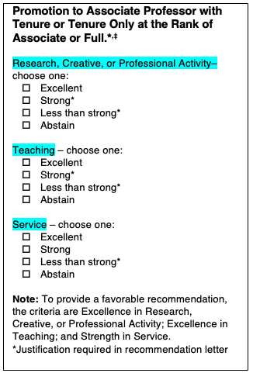
decision
II. Decision-making process
The ballot format is specific to the promotion type.
Step 4: The confidential vote
Tip for Chairs!
Prepare & print the ballots ahead of time to ensure:
the conversation covers the required areas
all votes are captured accurately.

Slide 31
After 3
III. After the meeting→ COMMITTEE LETTERS
Step 5: The committee letter
Strong letters accurately reflect the committee’s discussion and are complete with all required information. Ensure that your efforts to reduce bias in the review process continue into the letter writing.
Ways to ensure transparency in the letter writing process:
Point out the key evidence that the committee discussed.
Reflect both majority and minority opinions as required.
Include complete details of all votes & base the recommendation directly on the votes.
Share responsibility for taking good notes during the meeting to make drafting easier.
Include the names of all members who were eligible to vote; note any not present.
Note: The Provost’s Office will be sending you a document that outlines all the details you need.

Slide 32
review
Review the ADVANCE Best Practices to Address Bias in Personnel Decisions.
Our hope is that committee chairs and members will work together to implement measures to reduce bias!
More info can be found at
ADVANCE Office of Faculty Equity & Resilience
Personnel Protocol

Slide 33
COMMITTEE LETTER PRE-SUBMISSION CHECK
PLEASE PLAN AHEAD TO ALLOW FOR LETTER REVIEW
All committee members review the letter
DPC letters must be reviewed by Department Chair
(Where a Department Chair is a candidate, DPC letters must be reviewed by Dean)
CPC letters must be reviewed by Dean
After this review, committee chairs circulate the letter for members’ signature.
(DocuSign recommended; a single signature sheet with all members' signatures is acceptable)
The committee chair sends signed letters to pandt@uml.edu for upload, with a CC to candidate
DPC letter deadline: 10/26/26 - CPC letter deadline: 12/07/26
Note: The new pre-submission review process means committees must complete letters prior to the deadline to allow for review.

Slide 34
Chair/Dean Review OF COMMITTEE LETTERS
Chairs and Deans have been asked to confirm that each committee letter is valid on its face and aligns with the contract. Some of the details they will look for:
descriptors “excellent” and “strong” used only in the contractual sense
presence of substantive evidence for both majority and minority votes
complete voting details as the promotion type requires
names and ranks of all elected and ad hoc committee members
Chairs and Deans should not suggest changes in content beyond assuring that the letters meet all requirements for submission, and should not give feedback to the committee chair or its members about their decision. All review levels are separate and should reflect only the opinions of the committee.

Slide 35
TECHNOLOGY UPDATES
Simplified SharePoint site has replaced the P&T File Share
(VPN no longer needed)
DocuSign P&T PowerForm is available for DPC/CPC Chairs to gather committee member signatures. For assistance with DocuSign, reach out to the P&T team or your dean’s assistant.

Slide 36
UNIVERSITY RANK AND TENURE committee
URT will meet on Feb. 4 & 5, 2027, 9 a.m.-5 p.m.
Important Reminder: CPC Chairs serve on URT, so please mark your calendars!
In any case where the URT vote is not unanimously positive, the member from the candidate’s college will draft the committee recommendation, including an explanation of negative votes.
Members review and sign all completed letters via DocuSign.
Letters must be completed and signed by 02/16/27.

Slide 37
questions
Questions and discussion
For SharePoint instructions, the P&T calendar, guidelines,
and other information, please visit www.uml.edu/pandt
For additional questions, contact pandt@uml.edu

