Slide 1
Management Briefing Presentation
Instructions for users:
Use these management briefing slides to explain the Total Worker Health® concept and "pitch" the Healthy Workplace Participatory Program in your organization.
Refer to the Notes View for talking points
Customize Slides 2 and 3 with your organization's key issues and statistics.
Add slides as needed to reflect your organization's needs.
Notes:
Be sure to hide this slide before presenting the Healthy Workplace Participatory Program (HWPP) to your organization.

Slide 2

Total Worker Health® and [Organization Name]:
Advancing Safety, Health and Well-Being for Our Workforce
Notes:
Today, I’d like to introduce a new approach for managing safety, health, and well-being for our people at [Organization Name].
The new concept is called the Total Worker Health approach.
As the name implies, it’s a holistic, integrative concept that can take our current safety and wellness programs to the next level to be more effective.
I’d like to spend a few minutes explaining the concept and how we might adopt it.
At the end, I’ll ask for your reactions and suggestions for how we can move this concept forward here at [Organization Name].

Slide 3
Workforce Safety & Well-Being
Is Mission Critical
In [Organization Name], the safety, health, and well-being of our workers supports our mission by ensuring [Insert values / priorities (e.g., quality, performance, patient care, etc.)]
Key safety/well-being issues affecting our performance:
  Issue 1
  Issue 2
  Issue 3
  [Insert your organization’s issues; Use statistics if available]
Notes:
Protecting our workforce’s safety, health, and well-being is essential to achieving our business goals.
We rely on our people being physically and mentally equipped to meet strategic goals like [goal 1, goal 2, goal 3].
Key challenges facing [Organization Name] include [issues listed on slide; Highlight employee safety, health, or well-being issues that conflict with your mission and priorities].
[Organization Name]’s costs include:
Direct costs: workers' compensation, health care
Indirect costs: overtime, turnover, replacement, lost productivity
While we’ve made progress, the safety field is evolving with more effective approaches.
Leading-edge practice now embraces the Total Worker Health approach—an integrated strategy to advance all workers’ health, safety, and well-being.

Slide 4

Current State:
Siloed, Top-Down
Notes:
To tackle our challenges, we must close a gap in how we deliver programs to our workforce.
Currently, safety, health, and well-being are handled in silos, which can cause:
Fragmentation: Departments miss chances to share resources and expertise.
Missed connections: We may overlook links between mental health, culture, work design, and work-life balance.
Limited impact: Without worker input, we may miss key drivers behind poor outcomes. Worker involvement helps uncover root causes and leads to practical, accepted solutions.
Today’s safety and health issues are complex and require integrated solutions.
The Total Worker Health approach emphasizes integrating safety and wellness efforts to close these gaps.

Slide 5
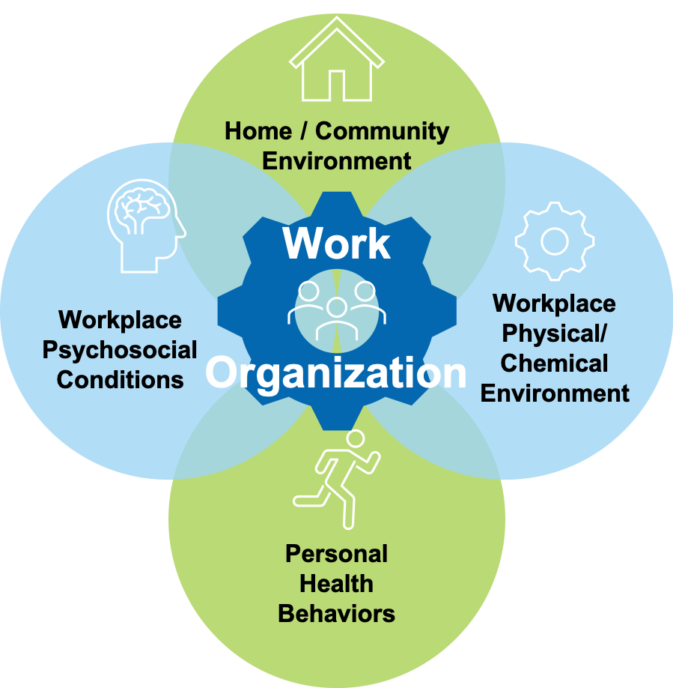
Future State:
An Integrated
& Collaborative
Total Worker Health
Approach
Notes:
The Total Worker Health approach takes a holistic, “whole person” view of safety, health, and well-being.
This image shows how multiple factors—at work and beyond—influence worker outcomes.
At work, both physical and mental demands matter, while outside of work, home, community, and personal health also have an impact.
The work process (the central gear) affects all these areas.
Unlike traditional, siloed approaches, the Total Worker Health approach considers all these dimensions together.
It’s more than adding wellness to a safety program—it emphasizes creating a healthy work environment and engaging workers in practical, lasting solutions.

Slide 6
Benefits of Worker Participation in
Total Worker Health Programs
Short-Term Benefits:
  Morale and job satisfaction
  Worker ownership of solutions
  Communication, collaboration, and teamwork
Long-Term Benefits:
Injuries and accidents
Work-related stress
Chronic disease burden
Notes:
Involving workers in solutions to health, safety, and well-being concerns is not just a good practice; it's a strategic approach that brings numerous benefits to both employees and the organization as a whole.
In the short term, workers who participate in job quality efforts have greater opportunities for job satisfaction, ownership of new solutions, and for collaborating effectively for positive changes.
All of this promotes a strong safety and health culture.
In the long term, positive changes can lead to reductions in injuries, work related stress, and chronic conditions that can be tied to unhealthy work conditions.
By including workers in developing solutions to health, safety, and well-being concerns, organizations create a collaborative and empowered workforce that is not only safer but also more resilient and productive.

Slide 7



Healthy Workplace Participatory Program
Notes:
Now that we’ve reviewed why a Total Worker Health approach is important, I’d like to introduce a research-based program called the Healthy Workplace Participatory Program (HWPP).
The HWPP was created and has been field-tested by university researchers at the Center for the Promotion of Health in the New England Workplace, or CPH-NEW, and supports an integrated, participatory Total Worker Health approach adaptable to different work settings.
In 2022, the Surgeon General released a workplace mental health framework highlighting essentials like protection from harm, connection, and feeling valued.
The HWPP supports all of these by giving workers a voice in shaping a workplace that supports both physical and mental health.
Next, I’ll explain how it works and why I believe our organization could benefit from trying this program.
At the end, we can discuss your reactions and possible next steps for [Organization Name], and I’ll ask for your input on how we might begin.

Slide 8



Elements of the Healthy Workplace Participatory Program
Design
Team
Trained
Facilitator
Steering Committee
Notes:
The HWPP involves a unique two-committee structure that is supported by a Facilitator.
The first is a Steering Committee of senior leaders, and the second is a Design Team representing the broader workforce.
This arrangement ensures contribution and collaboration at all levels.
The steering committee is led by a ”Champion", typically a senior manager/executive within the organization.
This group gives input on priorities, receives and reviews proposals from the Design Team, and allocates resources to implement solutions.
The Design Team consists of front-line and supervisory workers who are assisted by a trained Facilitator (or Co-Facilitators). They select and analyze safety and health problems and recommend solutions.
Design team members get training from the facilitator on the design process and are responsible for representing their peers.

Slide 9
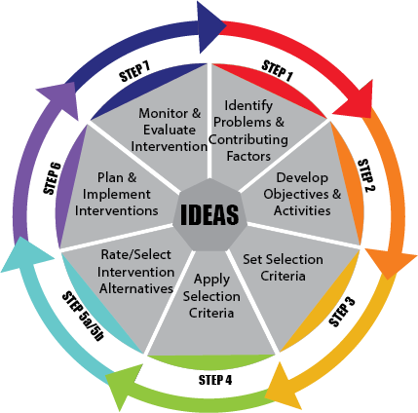
The Intervention Design and Analysis scorecards (IDEAS) Tool
The Intervention, Design, and Analysis Scorecard (IDEAS) Tool
The IDEAS Tool is a collaborative design process that:
Builds a business case
Creates integrated solutions
Notes:
The Second Core Element of the HWPP is the IDEAS design process.
This process uses concepts of continuous improvement and business case planning to produce workable solutions that align with resources and strategic goals.
This 7-step process builds integrative solutions one issue at a time.
It allows a team to thoroughly explore a range of root causes. It creates holistic, integrated solution alternatives for management to consider.
What differentiates this approach is the emphasis on solution building from the employee perspective. Why is this important?
When employees participate, they gain confidence in making changes for themselves and the organization.
When employees participate, they share their knowledge of the workplace.
This allows us, as leaders, to understand root causes of safety and health problems, and how those problems can be addressed most effectively.

Slide 10



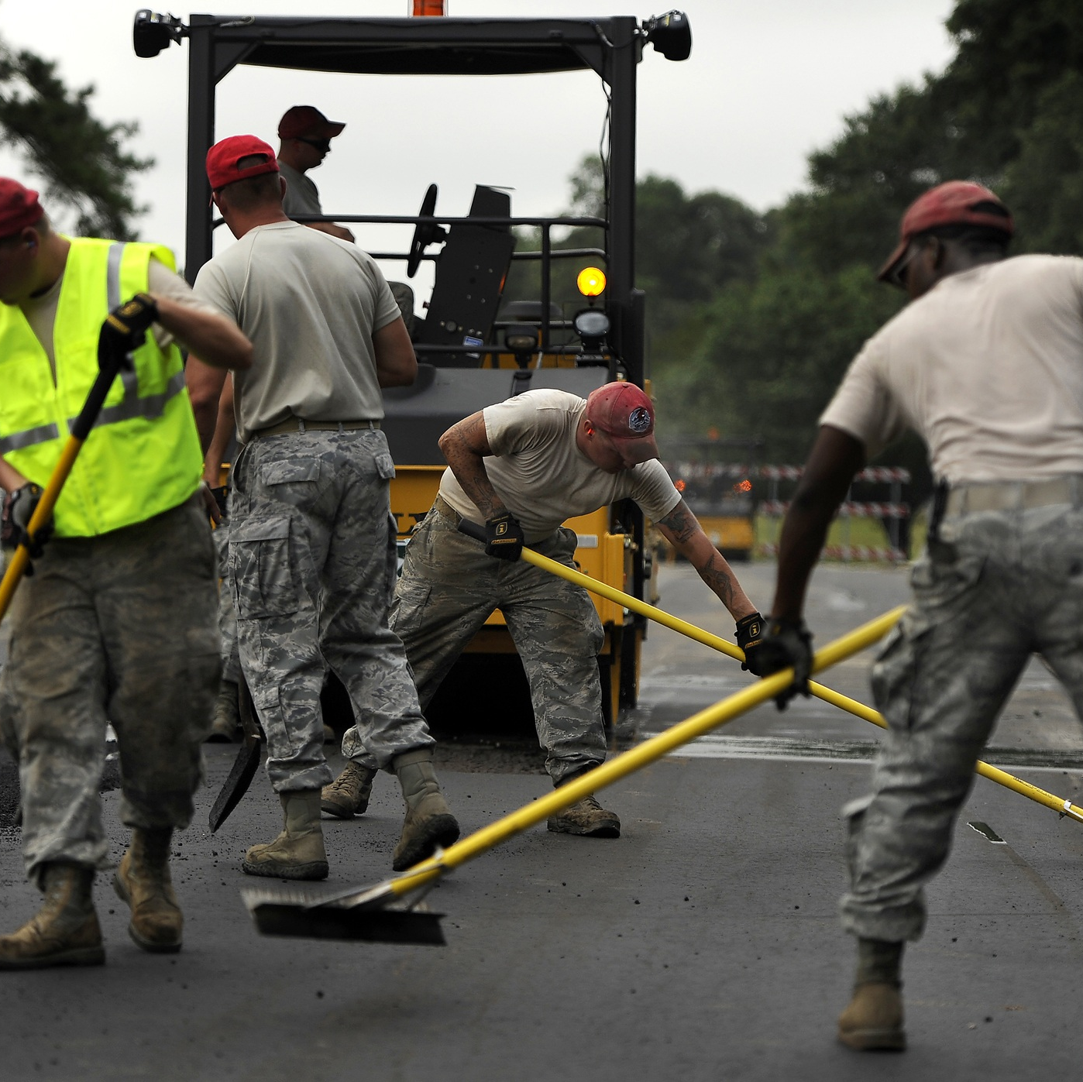
Where has the HWPP been successful?
Corrections
Healthcare
Education
Labor
Notes:
The HWPP has been successfully implemented in a variety of settings to address a range of physical and mental health issues.
Implementation and team structures can be tailored to fit different situations.
For example, a design team can be workers from a single unit, multiple units, or union groups.
Program activities can be customized for small or large workplaces.

Slide 11



Resources Available
HWPP Homepage
Case Studies
Notes:
The program website provides access to a wide range of materials.
The program materials are freely accessible, and training resources are available.
However, personnel resources would need to be allocated in our organization to get this off the ground.
Which is why we will conclude this presentation with feedback and discussion.

Slide 12

Let’s Get Started!
Are we ready to implement a Total Worker Health program?
Will the HWPP benefit our organization?
If yes, consider the next steps:
  Who would fit the Champion role?
Assess organizational readiness (short survey)
Notes:
What are your questions and comments?
How can we move this forward?
The next steps would be deciding who will serve in the ”Champion” role.
Champion Definition: Executive or senior-level leader; takes an active interest in worker safety, health, and well-being; has budget and policy authority.
Once a Champion is in place, we should assess the resources needed and available to support program implementation.
Phase 1 of the program recommends doing this using the HWPP’s Organizational Readiness Toolkit.

