Slide 1



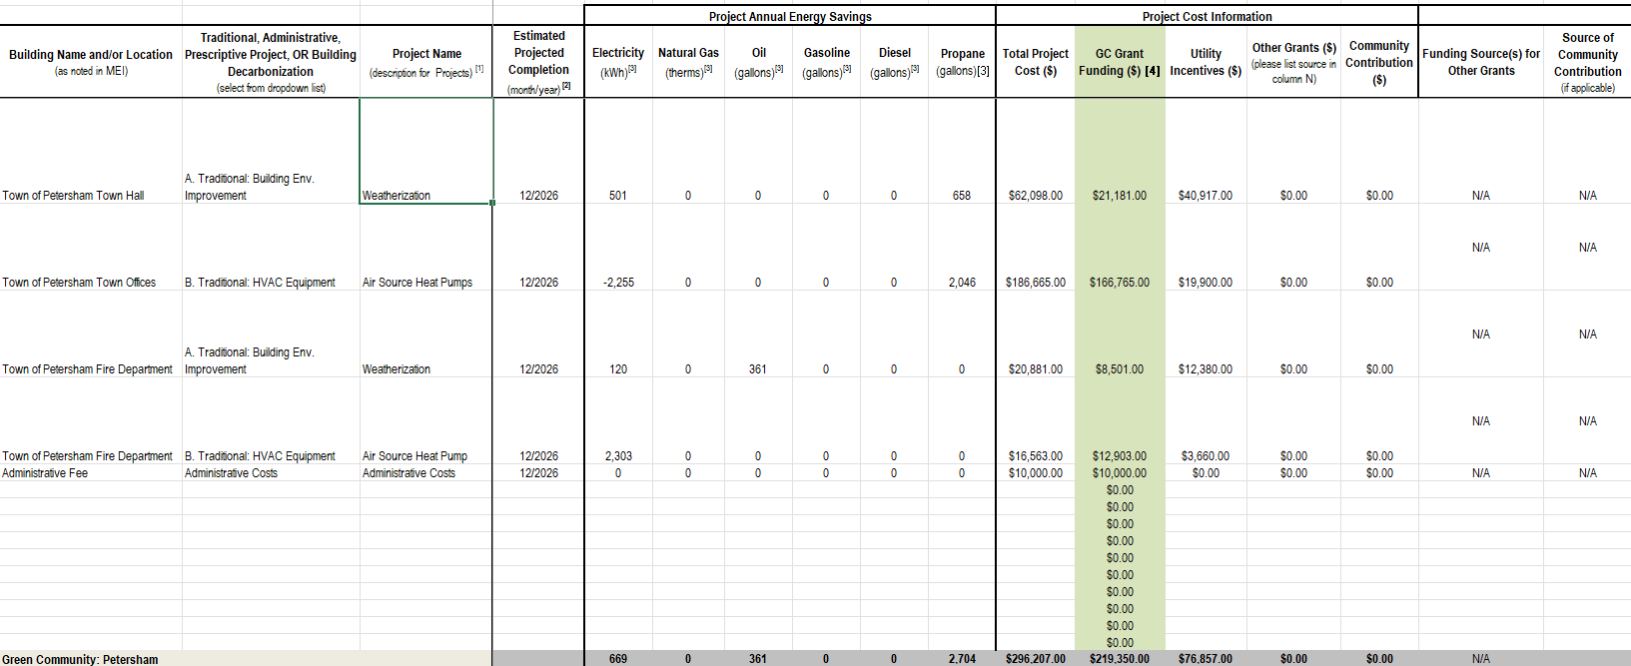
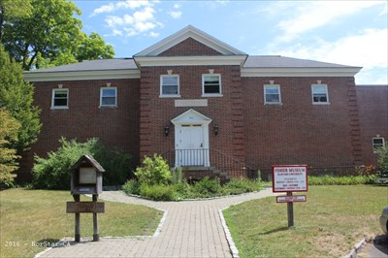
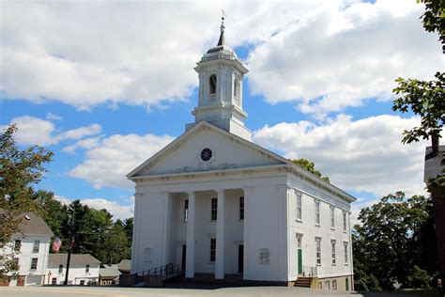
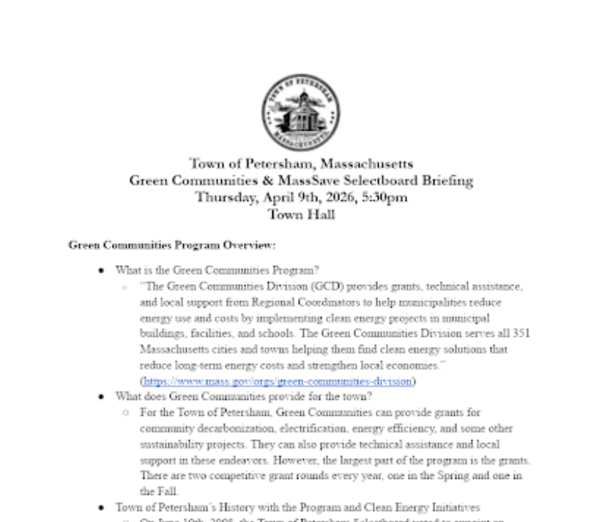
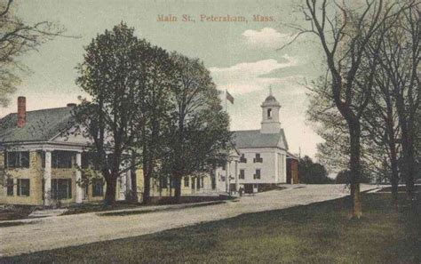
Old Town New Futures:
Sustainability Funding for Petersham
Ashley Gast, Clark University, Environmental Science & International Development
Town of Petersham, Deb Poodry
Contact: AGast@clarku@edu
Project Overview & Objectives
Deliverables and Findings
Main Takeaways
Petersham Context & Challenges:
The vast majority of land in Petersham is conserved land, including part of the Quabbin Reservoir and the Harvard forest. Thus, new construction and development is usually hindered.
State of Municipal Buildings: Most of the five municipally-owned buildings, as well as the other community buildings in town, run off fossil fuels and/or have not been weatherized or electrified. Many are also historical buildings, so maintaining their character is paramount.
Project & Objectives: I compiled research, wrote, and submitted a Green Communities Competitive Grant for $219,350 to fund four weatherization and heat pump projects for three municipal buildings.
Why this Project: In order to work towards substantial and cost-effective decarbonization, the buildings need to be weatherized to reduce the energy needed for climate control and electrified so that they may eventually be connected to clean energy sources. This project sets Petersham on a path towards municipal decarbonization.
Current Situation: Awaiting Award Response
[Insert figure/diagram if helpful]
Findings: The town of Petersham has had no decarbonization work done in over 10 years. Many of the municipal buildings are uninsulated and still have gas-based heating systems. Before they can be converted to green energy, they must be weatherized and decarbonized first.
MassSave Initial Proposals: Representatives from Energy Source sent us proposals for projects with MassSave incentives. These included a heat pump for the Fire Station, weatherization projects for the Fire Station and Town Hall, and LED lighting projects for multiple municipal buildings.
MassSave Additional Proposals: Given that the Town Offices building was as well-weatherized as it could be, I worked with representatives from energy source to push for a heat pump proposal for the Town Offices building. They performed the analysis for us, and it transformed the Green Communities Grant proposal I wrote.
Final Results: We found that the lighting proposals were not feasible for the town, as the Green Communities Grant does not fully fund these projects. This led to a final submittal of four projects. If funded, these projects will not only reduce greenhouse gas emissions, but they will also save Petersham thousands of dollars a year.
A Green Communities Competitive Grant application was submitted on April 10th. Below are the grant proposal grid outlining the details of the four projects and the first page of the five-page briefing I presented to the select board on April 9th, 2026.
Takeaways:
Bureaucratic processes & Equitable Access: State processes can be difficult to navigate for small towns without the expertise to navigate it. State laws that streamline these processes and provide assistance made learning these systems easier for both me and relevant local stakeholders.
Community Resource Challenges: Petersham, and towns like it, are too small to regularly have spare monetary resources to fund clean energy infrastructure projects, as well as other improvements, so grants are a critical part of the town’s monetary makeup. Additionally, without a person or committee
Impact For Sustainable Energy: The project I pursued makes the transition to clean energy for Petersham feasible. Putting efforts into projects like these across the state ensures rural populations are not left behind and the state achieves its climate goals.
Future Plans:
Future Green Communities Work: Work will focus on the implementation of these projects and submitting greenhouse gas emissions data to maintain Green Communities status.
Assistance for Private building decarbonization: Provide educational materials for town residents and search for grant opportunities to fund clean energy projects for community buildings, such as the library.
LED Light Changes: Collaborate with National Grid, the Select Board, and State Regulators to implement LED lighting changes that meet environmental and dark sky standards that the town wishes to implement.
Mapping the Green Energy Future for Petersham: Acquire feasibility analyses for clean energy alternatives for town and community buildings, such as geothermal and solar.
And more!
Some photos of Petersham below:
Approach and Methods
Community Outreach: Discussed concerns with multiple community members and stakeholders through informal meetings.
MassSave Analyses: Reviewed analyses and proposals from MassSave and commissioned additional proposals for heat pumps
Clean Energy Research: Conducted research on best path forward for municipal building decarbonization and the processes required
Green Communities Assistance: Met with the Green Communities Regional Coordinator to discuss grant process & details.
Historical Building Considerations: Investigated policies about historical buildings and processes for renovation and construction approval.
Acknowledgements
• Deb Poodry, Chair of the Select Board
Sherry, Administrative Coordinator
Mark Rabinsky, Green Communities
Devon Millici, CELT Coordinator
Currently, we are waiting for the results of the Spring Green Communities Competitive Grant Round. We expect a response in July or August, and hope that we will be able to move these projects forward.
CELT Fellowship Celebration
June 16th | Boston University

