Slide 1
Creating A Solution
Valerie Kijewski, Ph.D.
Manning School of Business
Difference Maker Program

Slide 2
So Far, You Have…
Defined the Problem your Team is Solving
Problem Statement
Who is affected by problem?
How are they affected by problem?
Why is it important to solve this problem?
Assessed the Opportunity
Who currently addresses this problem?
How is the current solution delivered?
How effective is the current solution?
What can be improved? Alternative approach?

Slide 3
Now We Discuss Value
Customer Value
Including patients, clients, customers
The groups who are affected by the problem
Business Value
How you will operationalize your solution
How you will support/sustain your solution

Slide 4
Question Addressed Today
What part of the problem are you trying to solve?
What value do you deliver to the affected group?
What are the costs / revenues associated with your solution?
How will you sustain your solution?

Slide 5
It Takes A Community . . .
You must build a sustainable organization to help solve real-world problems and provide value to constituents (customers) over time.

Slide 6
What Is A Business Model?
A business model describes the rationale of how an ORGANIZATION
creates, delivers, and captures value.

Slide 7
The Business Model Let’s go to the movies . . .
http://www.businessmodelgeneration.com/canvas

Slide 8
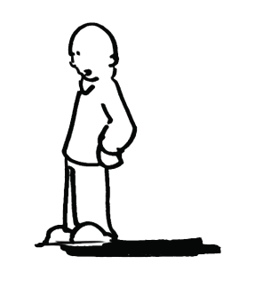
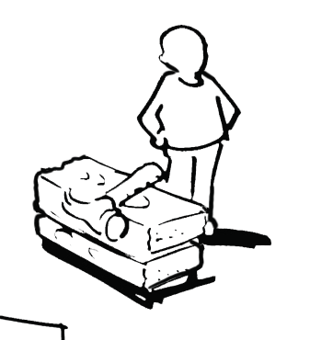
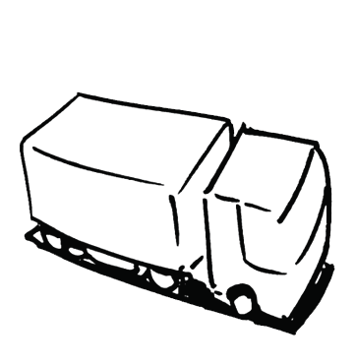
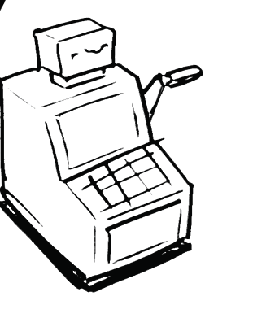
Business Model
KEY
PARTNER
KEY
ACTIVITIES
Value
Proposition
RELATIONSHIPS
CLIENTS
KEY
RESOURCES
CHANNELS
COST CENTRES
REVENUE STREAMS

Slide 9
Canvas Building Website
http://www.canvanizer.com
http://canvanizer.com/canvas/BAdYUohxD2o

Slide 10
Start-Ups

Slide 11
Student Name: Derek Coleman
Business Description: University Transportation service for students to travel to events safely
ff
Key
Activities
Key
Partners
Value
Proposition
Customer
Relationships
Customer
Segments
Create ecosystem to keep students on website, mobile, or marketing list
Bus companies
Trustworthy, brand worthy
College students (who don’t have a ride or want to travel with friends + friends who they travel with
Venues
Atmosphere on the bus, reputation
Fun, exciting, good time
Universities
Cheap, safe, caring
Customer experience
Key
Resources
Channels
Freshman
Transport students safely, gain a good reputation
Transportation. (Safe, cheap, convenient) to events
Website
Parents looking to keep their kids safe when going to events
Website
Sign-up application
Employees/legal team
On campus marketing
Get feedback, improve
Social media accounts
Socially responsible students
Cost Structure
Revenue Stream
Cost more for trips with less people.
Money generated from trips. Preferably $500 profit per trip after COGS
Looking for $500 profit after all variable expenses.
Selling booklets in advance for 10 trips that semester.

Slide 12
Not-For Profit Model
Mission
Donor
Key
Partners
Customer
Relationships
Key
Activities
Value
Proposition
Customer
Segments
Channels
Key
Resources
Product or
Service
Recipient
Free
Cost Structure
Revenue Stream
Donation

Slide 13
Lazarus House Ministry Inc.
Key partnerships
Key activities
Value propositions
Customer relationships
Customer segments
Meals
Shelter
Counseling
Health Care
Community Members
Personal Assistance
People living in poverty (Recipients)
Community Members
Donors
KA
Fundraising Coordinator
Admission Management
Donor Management
Local &Corp. Businesses
Charitable Foundation
Individuals (Volunteers)
Churches
Social Enterprises
Greater Lawrence Health Center
Gains
Empowerment
A job
Permanent housing
Resources
Gains
Shelter
Meals
Community
Security
Work Prep
Key resources
Channels
Pain Relievers
Diminishes concerns
Eliminating hunger
Donors?
CH
Lazarus Locations
Volunteers
Staff
Donated Items/monies
Online donations
(www.lazarushouse.org)
Thrift Shop
Good Shepherd’s Center
Lazarus Locations
Pains
Overcrowded shelters
Little privacy
Time constraints
C$
R$
Cost structure
Revenue streams
Free
Administrative costs
Fundraising costs
Utility costs
Donations
Fundraisers
Thrift Shop Sales

Slide 14
Critical Issue: Value Proposition – Customer Fit
Key
Partners
Key
Activities
Customer
Relationships
Value
Proposition
Customer
Segments
Key
Resources
Channels
Dynamically Interdependent
Cost Structure
Revenue Stream

Slide 15
Customer Discovery Process
Start with a vision (a solution to a problem)
Customer Discover process searches for problem/solution fit
Does your value proposition match customer segment it plans to target?
Develop the product for ‘the few’, not everyone
Get Market Feedback
Build a ‘minimum viable product’ (MVP)
Don’t add features without feedback!

Slide 16
WHAT IS A VALUE PROPOSITION?
Let’s Go Back to The Movies
http://ecorner.stanford.edu/authorMaterialInfo.html;jsessionid=C88A82434C120C7FE39B9D5ABDD0494A?mid=2877

Slide 17
Map Customer to Value Proposition
Value Proposition
Customer Segment
Products
Services
Features
Wins
Results
Gains
JOB
To Be
DONE
FIT
Pain
Killers
Pains
Getting The Customer Value Proposition Right Is Critical To Success

Slide 18
Explore Customer Pain
What does your customer find too costly?
(e.g., too much time, too much money, requires substantial effort, …)
What makes your customer feel bad?
(e.g., frustrations, annoyances, . . .)
How are current solutions underperforming for your customer?
(e.g., lack of features, performance, malfunctioning, accuracy…)
What negative social consequences does your customer encounter or fear?
(e.g., loss of face, trust, power, status . . .)
What’s keeping your customer awake at night?
(e.g., big issues, concerns, worries . . .)
What common mistakes does your customer make?
(e.g., usage mistakes, inappropriate priorities . . .)
What barriers are keeping your customers from adopting solutions?
(e.g., upfront investment, learning curve, resistance to change . . .)

Slide 19
Explore Customer Gains
Which savings would make your customer happy?
(e.g., time, money, effort, risk . . .)
What outcomes does the customer expect and what would go beyond expectations?
(e.g., quality level, more or less or something . . .)
How do current solutions delight your customer?
(e.g., specific features, performance, quality . . .)
How would you make your customer’s job or life easier?
(e.g., flatter learning curve, more services, lower cost of ownership . . .)
What positive social consequences does your customer desire?
(e.g., makes them look good, increase in power or status . . .)
What are customers looking for?
(e.g., good design, guarantees, specific or more features . . .)
What do customers dream about?
(e.g., big achievements, big reliefs . . . )
How does your customer measure success or failure?
(e.g., performance, cost . . .)
What would increase the likelihood of adopting a solution?
(e.g., lower cost, less investment, lower risk, better quality . . .)

Slide 20
Exercise:
Customer | List Pains | List Gains
1.
2.

Slide 21
Job To Be Done
http://www.youtube.com/watch?v=s9nbTB33hbg&feature=player_embedded

Slide 22
Customer Discovery Interview
http://startupweekend.wistia.com/medias/tao3s8hf7l

Slide 23
A Day In The Life Of Your Customers
Exercise
Question | Customer 1___________ | Customer n____________
1. How Is Your Customer Currently Dealing With This Task/Problem?
2. What Are They Trying To Accomplish? Desired Outcome? Wish They Could Do?
3. What Approach Are They Attempting
4. What Are The Interfering Factors?
5. What Are The Economic Consequences? –Costs?

Slide 24
A Day In The Life . . .
Question | Customer 1___________ | Customer n____________
6. Your New Approach . . .
7. Enabling Factors?
8 Economic Rewards?
9. Is Our Price Consistent With Budget? – Problem Solved?

Slide 25
How can I find customers before I’ve even built a product?
How were you planning on finding them after you’ve built a product?

Slide 26
Finding People . . .
AdWords / Facebook Ads /Tweets
Summarize your idea – get it on search engines
Twitter Search
Search for people who discussed _____
@username Would love yr feedback on [product/problem/solution] – shd only take 2mins [URL] thanks!
Google Alerts
Monitor the web for product/problem/solution
I read your [post/comment] about [product/problem/solution]. I’m currently trying to validate a related idea and I think your opinion would be very valuable to me – could you take 2 minutes and check out [URL]? Thank you – I’d be happy to return the favor any time.
LinkedIn to ask for Introductions

Slide 27
Customer Segments (Customer Archetype) Groups That Rank Importance Differently!
Needs
Amateur Camera
Professional Camera
Ease of Use
Weight
Lens
Options
Size
Auto Focus
Lesson: Customers Buy Your For Your Strengths

Slide 28
– Business Model
KEY
PARTNER
KEY
ACTIVITIES
Value
Proposition
RELATIONSHIPS
Customers
How do we acquire
customers?
What is Cost To
acquire a customer
or donor?
What must we do:
-Better than comp.
–Extremely well
vs. outsource
What?
-Pain Killers
- Gains given
Who?
-Jobs to get done
-Pains relieved
-Gains sought
Who do we need
to partner with?
What do they
bring to the table?
- Access?
-Efficiency?
-Capabilities?
-Credibility?
KEY
RESOURCES
CHANNELS
What unique
resources do we
need/have?
- IP
- Information
-Access
-Skills
How do we reach
our clients?
COST CENTRES
REVENUE STREAMS
Cost Structure?
- Fixed
- Variable
Sustainable?
- On-going full costs covered?
- Adequate cash flow (cigar box)
Revenue Sources?
- One, Multiple?
- Sustainable?
Economics?
-Break-even Volume
-Cash Required?

Slide 29
Go Build Your Initial Business Model (But Expect To Revise It Often As You Learn and Grow)

