Slide 1
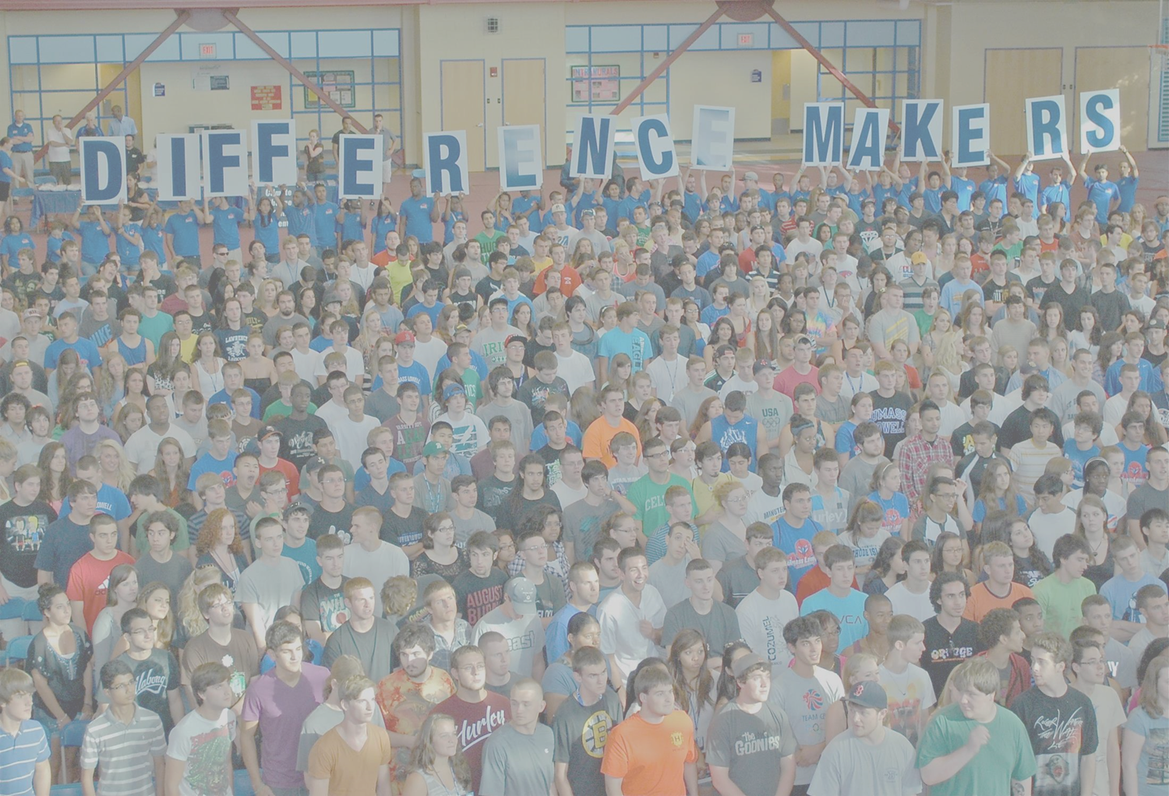
2016 DifferenceMaker $35K Idea Challenge
Workshop 1: Identifying Problems
February 11, 2016
Makerspace, FA 102, North Campus
5:30-7:30p.m.
Guest Speaker Nancy Saucier, Director New Venture Development

Slide 2
Agenda
5:30 Introduction: Idea Challenge, Idea Plan, Problems you want to solve
5:45 Sharing Ideas
Team Building What Makes a “Good” Problem?
6:15 Activities:
Team Brainstorming around Problems Reporting Back
7:15 Discussion of Next Steps

Slide 3
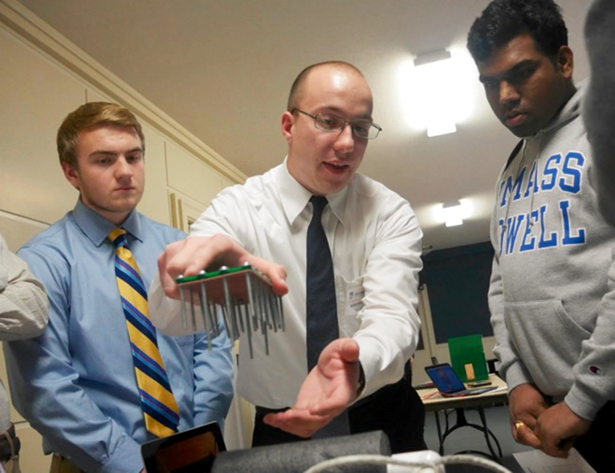
2016 $35K Idea Challenge
48 applications this year!
All 6 colleges participating
New products, new services, new causes

Slide 4
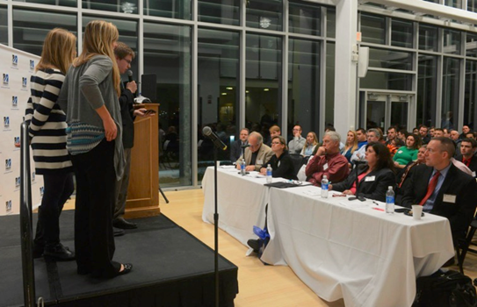
Now What?
The Kenders impress the judges at the 2015 Preliminary Pitch-off
10 weeks to the 2016 Idea Challenge
Preliminary Pitch-off: April 1
2016 Idea Challenge: April 13
Build your Team
TeamMaker
Attend the workshop series
Research your Problem, Opportunity, Solution and Resources
Use the DifferenceMaker Toolkit (template given out and found online)
Develop your Idea Plan and Rocket Pitch: Due Feb. 29
Idea Plan template given out and found online
Rocket pitch template found online
Develop a Poster (template found online): Due March 23
Then impress the Judges!

Slide 5
What’s an Idea Plan?
A succinct summary outlining:
Problem you are addressing
Why is it important? Who cares?
Opportunity associated with solving the problem
How big? How many? How much? How else?
Solution
Specifically -- how will you address this problem?
Resources - Request & Rationale
Budget, Timeline, Team
Based on Research, NOT your opinion!

Slide 6
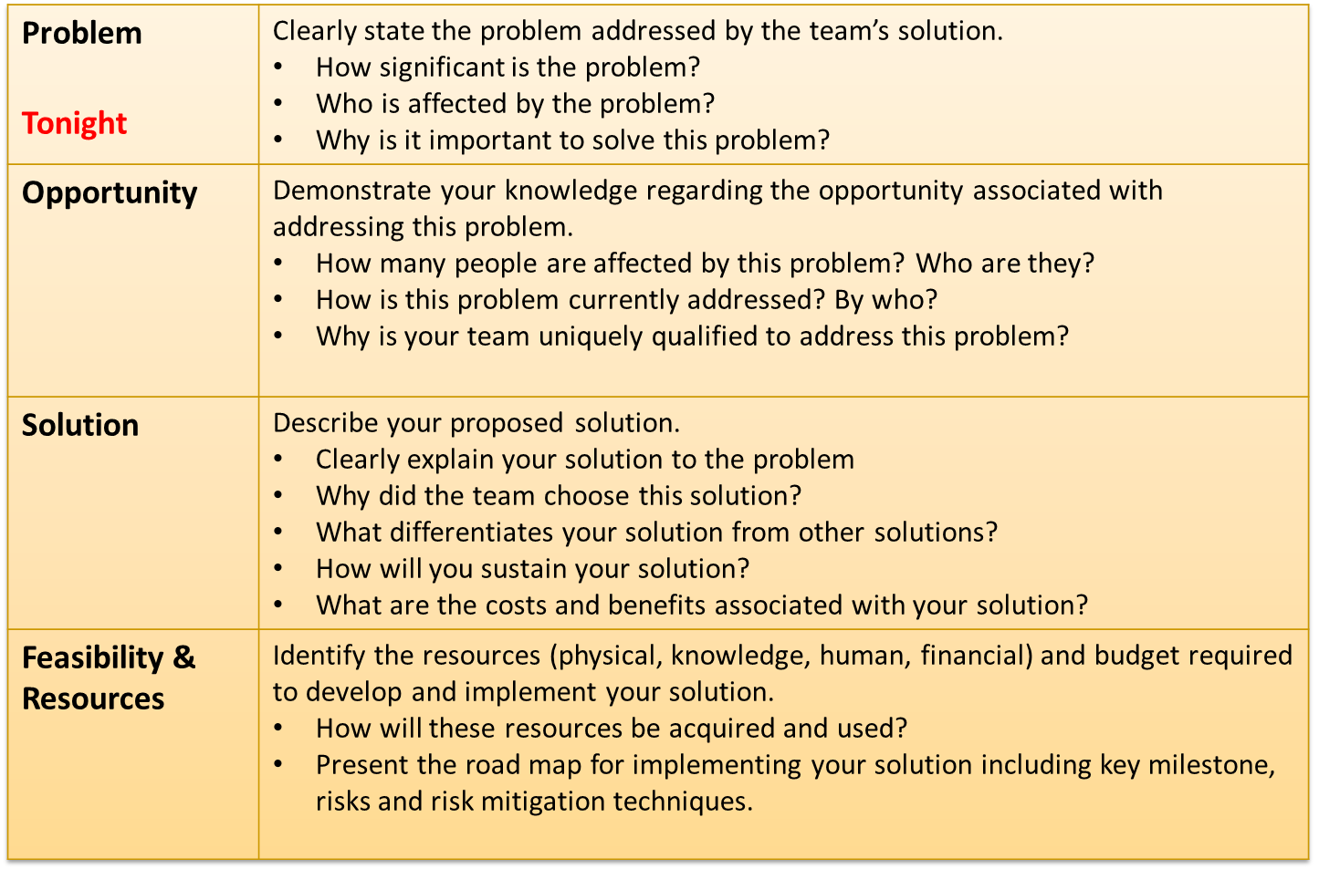
DifferenceMaker Method and Idea Plan

Slide 7
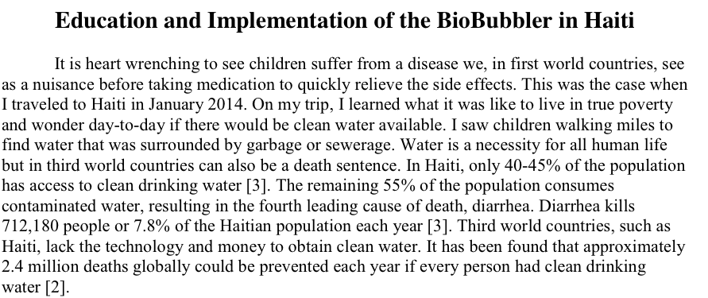
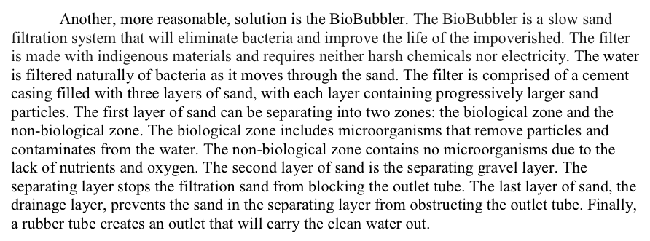
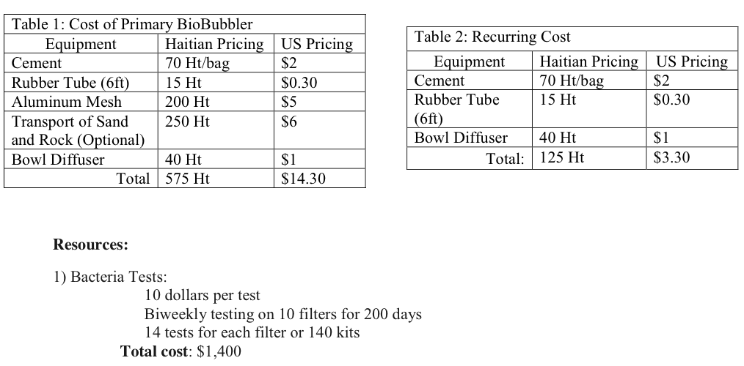
Idea Plan Examples

Slide 8
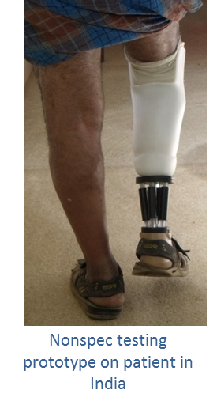
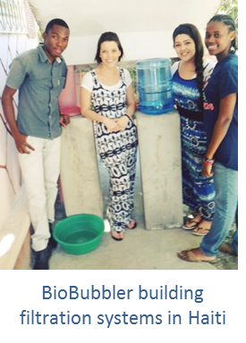
What Makes a Good Problem?
A problem that matters to you, and to others
Typically a problem with some social importance
A problem that others understand
Can you can quickly explain the problem in a way that others understand?
A problem that elicits multiple perspectives
A problem with tangible solutions
A problem that maps to the DifferenceMaker award categories
Campus Wide DifferenceMaker
Significant Social Impact
Contribution to a Healthier Lifestyle
Innovative Technology Solution
First to Market

Slide 9
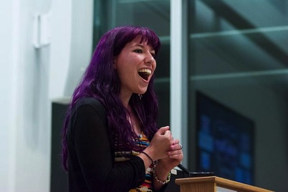
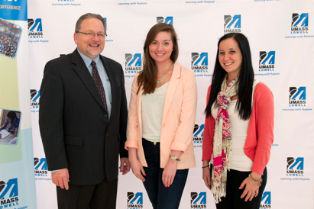
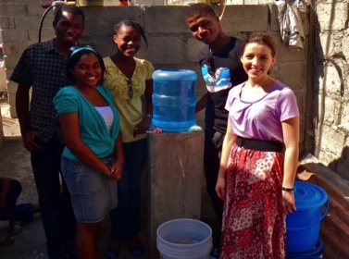
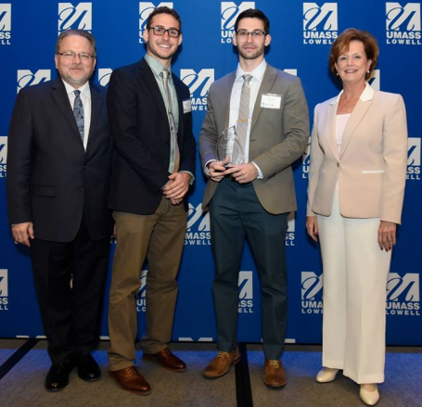
Real-life DifferenceMaker Team Problems
Fresh Beets
First To Market, 2014
Healthy Habits
Significant Social Impact, 2013
BioBubbler
Sustainable Environment, 2014
Masela Dentures
Innovative Technology, 2015

Slide 10
Activity #1: Who has a Problem? Define your Problem
In 1 minute:
Introduce yourself
State the problem you want to solve
Do you need additional teammates to help you solve your problem?
Who do you need?
Persuade potential team members to choose your problem
Write your problem on poster paper and stand by it
DifferenceMakers: If you love it, choose it

Slide 11
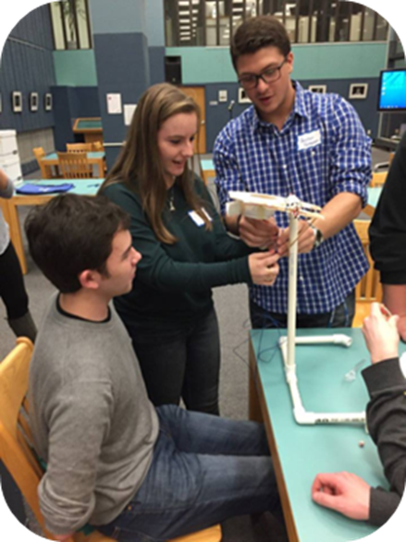
Still Haven’t Found What Your Looking For?
Pick a team for tonight, but keep searching for a team and additional teammates
Visit TeamMaker: Team building platform
www.uml.edu/ideachallenge
Click TeamMaker link
View the lists
Log in with your student credentials
Input your information
Find additional teammates: Build a Team
Join a team: Seeker
Connect with them!

Slide 12
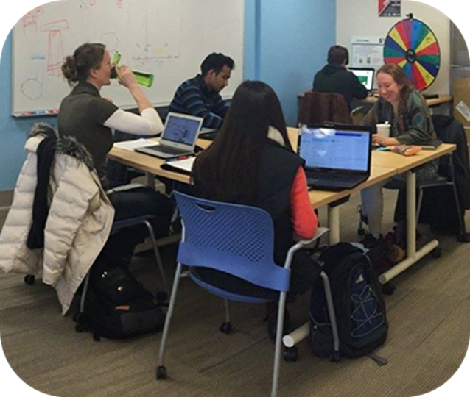
Activity #2: Refine your Problem as a Team
10 Minutes!
Use the toolkit problem worksheet
Clearly state the problem you want to solve
Discuss who you think is affected by your problem
It will then be defined with your research
Specifics count here!
Who? How many? Demographics?
How are they affected?
Take a Guess if You Don’t Know
It will be defined through your research
How important is it to solve this problem?
Why? You are Brainstorming
There is NO Wrong Answer
Support our Students, 2014 Campus Wide DifferenceMaker team, refines their problem in DifferenceMaker Central

Slide 13
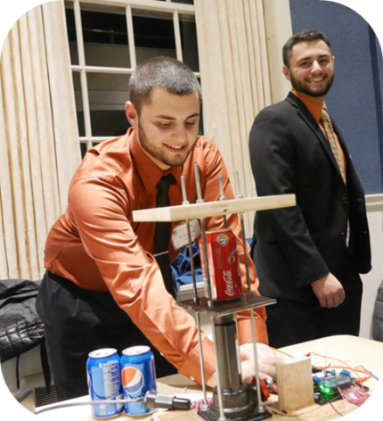
DifferenceMaker Toolkit: Problem Worksheet
What is the problem you wish to solve?
Who is affected by the problem?
How significant is this problem?
Why is it important to solve this problem?
What don’t you know about this problem?
What do you need help with?
Where can you find answers?
Be SPECIFIC

Slide 14
Activity #3: Tell us About Your Team and Your Problem
Elevator Pitch: 1 Minute!
Introduce your team
Tell us about the problem you are solving
What you know/assume about the problem so far?
Do you need additional help or team members?

Slide 15
Problem: From Simple to Defined
Third world countries
lack the technology and money to obtain clean water
2.4 million deaths can be prevented each year if every person had clean drinking water
Remember BE SPECIFIC

Slide 16
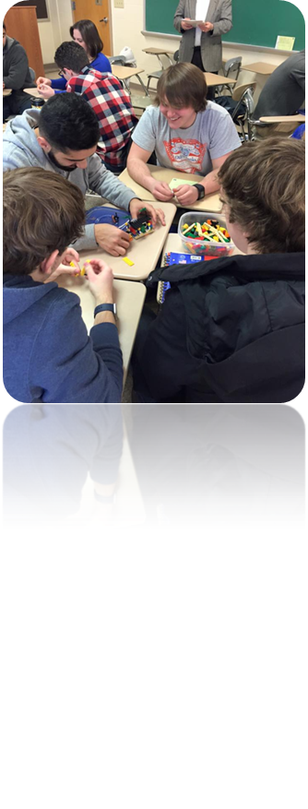
Test your Assumptions
Talk to at least 25 people who are affected by your defined problem
Utilize the Library Databases
Contact Donna Mullin, Business Reference Librarian
Lydon Library, 2nd Floor
Donna_Mullin@uml.edu, 978-934-4579
Talk to DifferenceMaker Faculty Fellows
www.uml.edu/DifferenceMaker/Faculty
Talk to your Peers
Use the DifferenceMaker Resource Page
www.uml.edu/DifferenceMaker/IdeaChallenge
Click on the Resource tab

Slide 17
Deliverables!
Talk to at least 25 people related to your problem about the problem and be sure to capture the data!
Survey: Develop a list of 5-10 questions to ask them
Research and Capture:
Who is affected by the problem? How many?
Why is it important to solve this problem?
What bothers people the most about the problem?
How do they solve this problem now?
Who else has attempted to solve the problem?
How effective are current solutions/attempts?

Slide 18
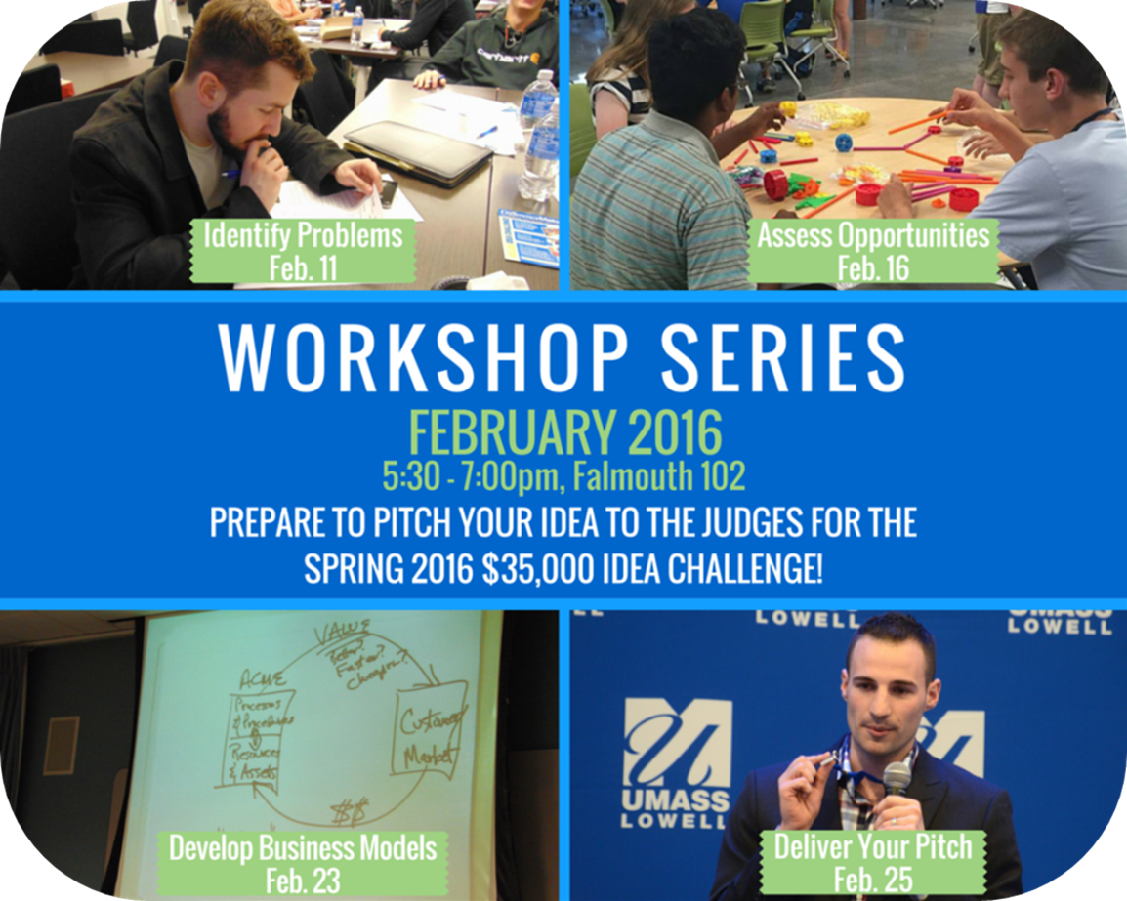

Slide 19
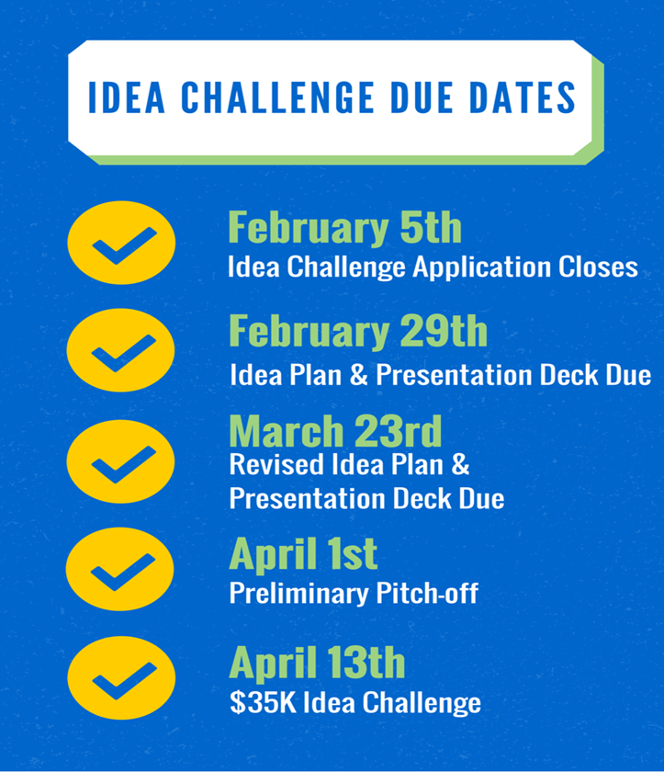

Slide 20
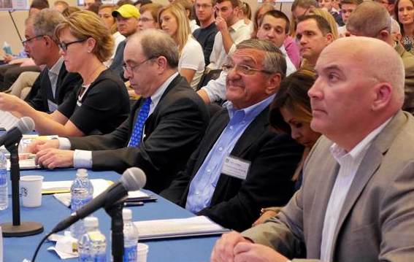
Idea Plan and Rocket Pitch
Judges want to see more research and data!
Judges want to know that you understand what it will take to actually implement your solution
Resources to help you find this information
Review the Idea Plan Handout
So you know what to expect
Due online, Feb. 29
Semi-finalist revised plans: Due online, March 23
As you go through the workshops and process, fill out your Toolkit and Idea Plan

Slide 21
Faculty Fellows and Staff
DifferenceMaker Faculty Fellows
Prof. John Brown Grad. School of Education
Prof. John-Morgan Bush FAHSS
Prof. Guanling Chen College of Science
Prof. Deborah Finch Manning School of Business
Prof. Stephen Johnston College of Engineering
Prof. Ralph Jordan Manning School of Business
Prof. Ainat Koran School of Health & Environment
Holly Butler, Ha Pho
Enterprise Co-op Scholars
Support of many others!

Slide 22
Recap: What’s Next?
Talk to 25+ people who are affected by your problem
Gather data and research (library database, talk to people…)
Fill out the problem worksheet
Look at the Idea Plan template and fill it out as you go
Due online, Feb. 29
Attend Workshop 2: Assessing Opportunities and Value Propositions
Feb. 11
5:30-7:30p.m.
Makerspace, FA 102, North Campus (right here!)
Guest speaker: Tom ODonnell, Director, Innovation Hub

Slide 23
Connect With Us!
differencemaker@uml.edu
www.uml.edu/differencemaker
@difference_UML
@differencemakeruml
blogs.uml.edu/differencemaker
facebook.com/umldifferencemaker
Email:
Website:
@difference_uml

