Slide 1


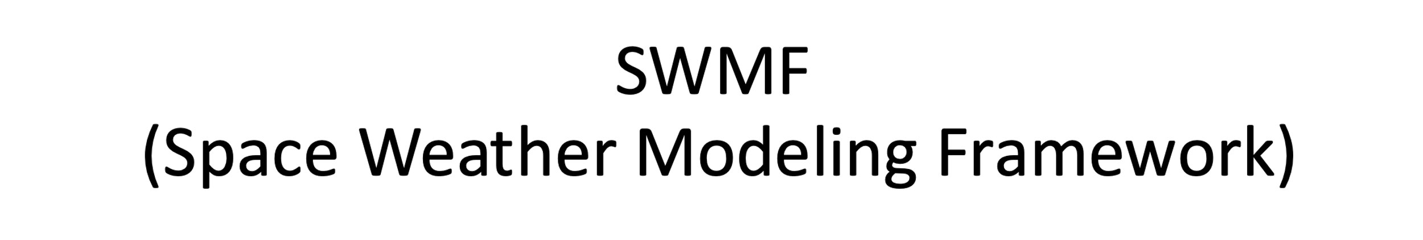
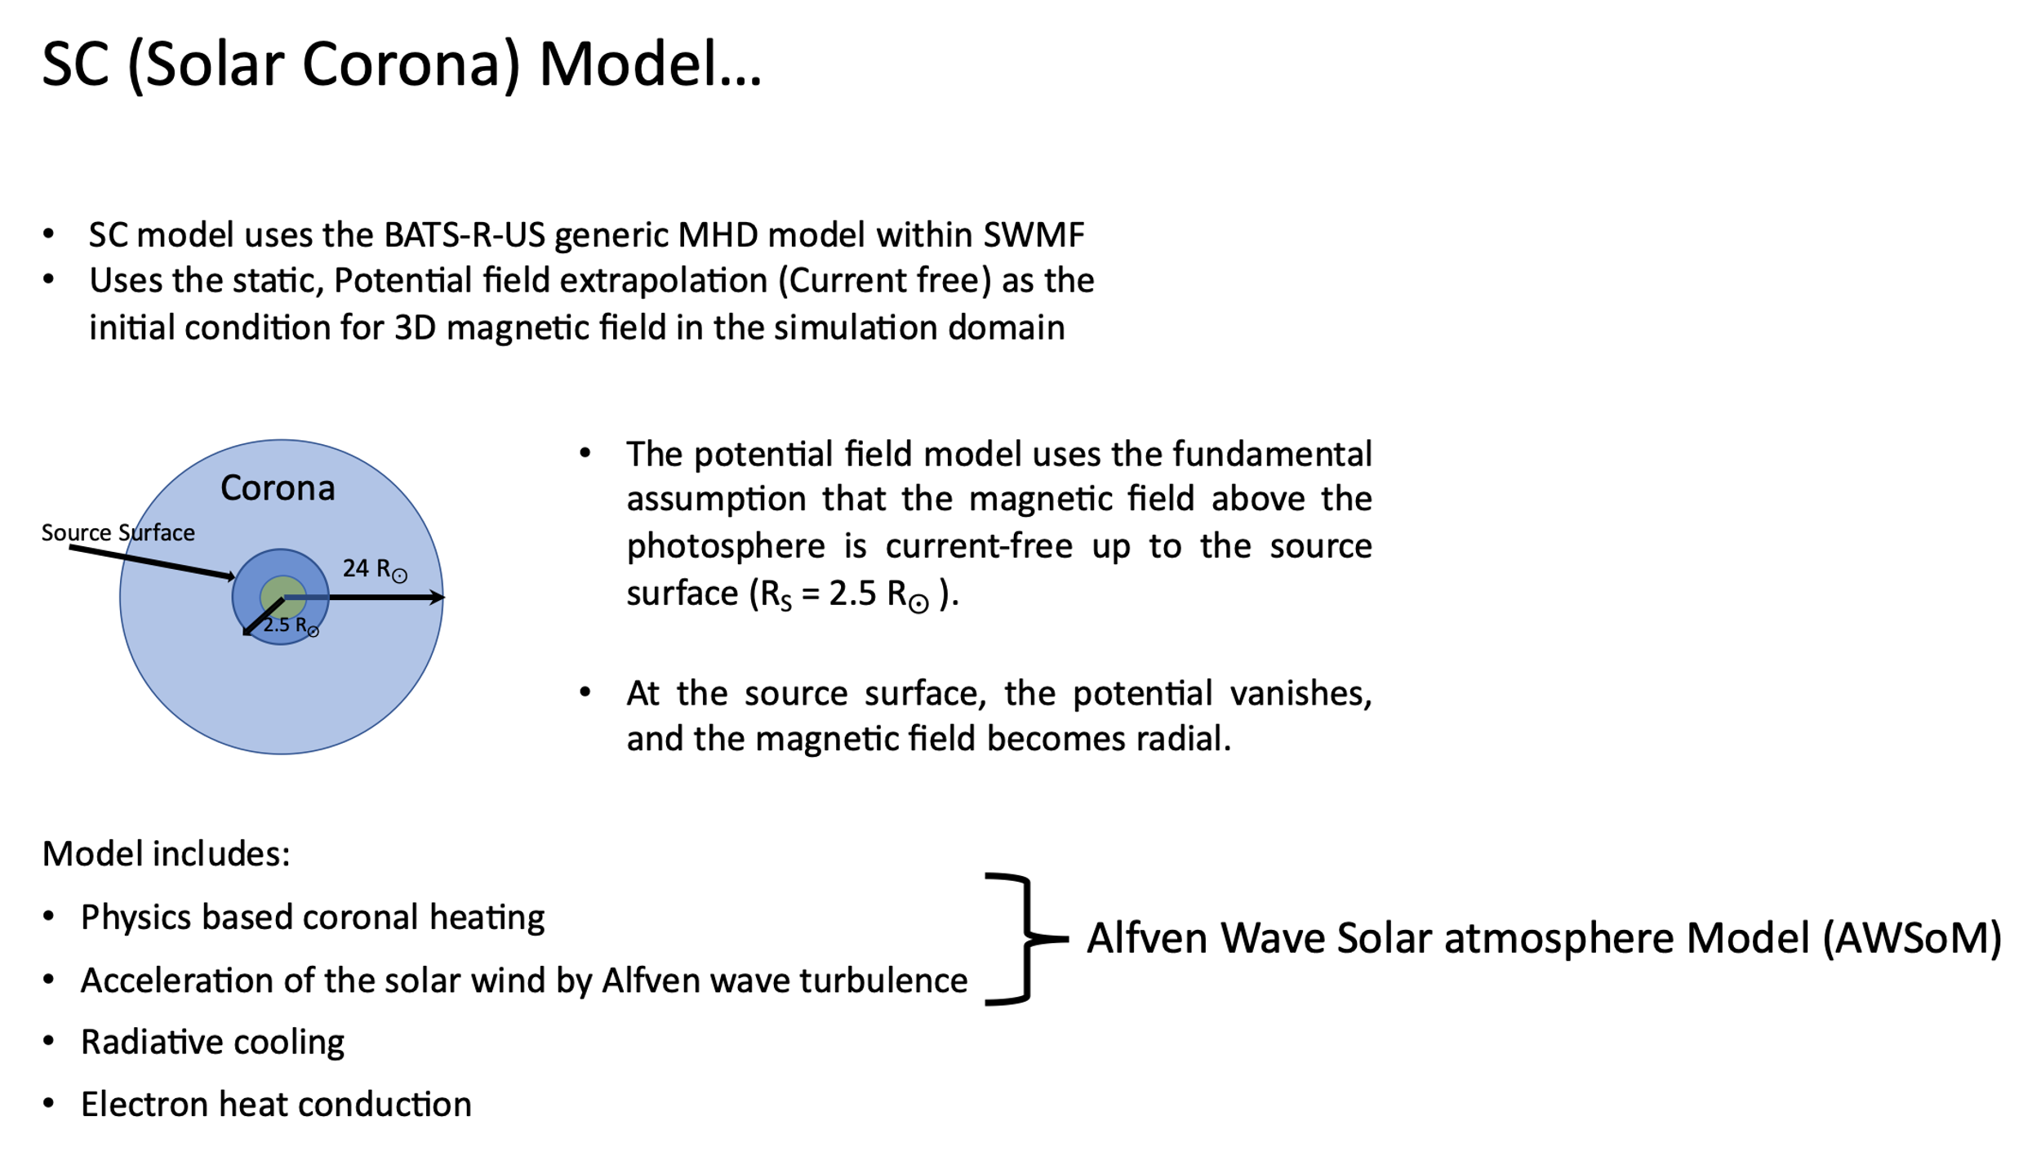
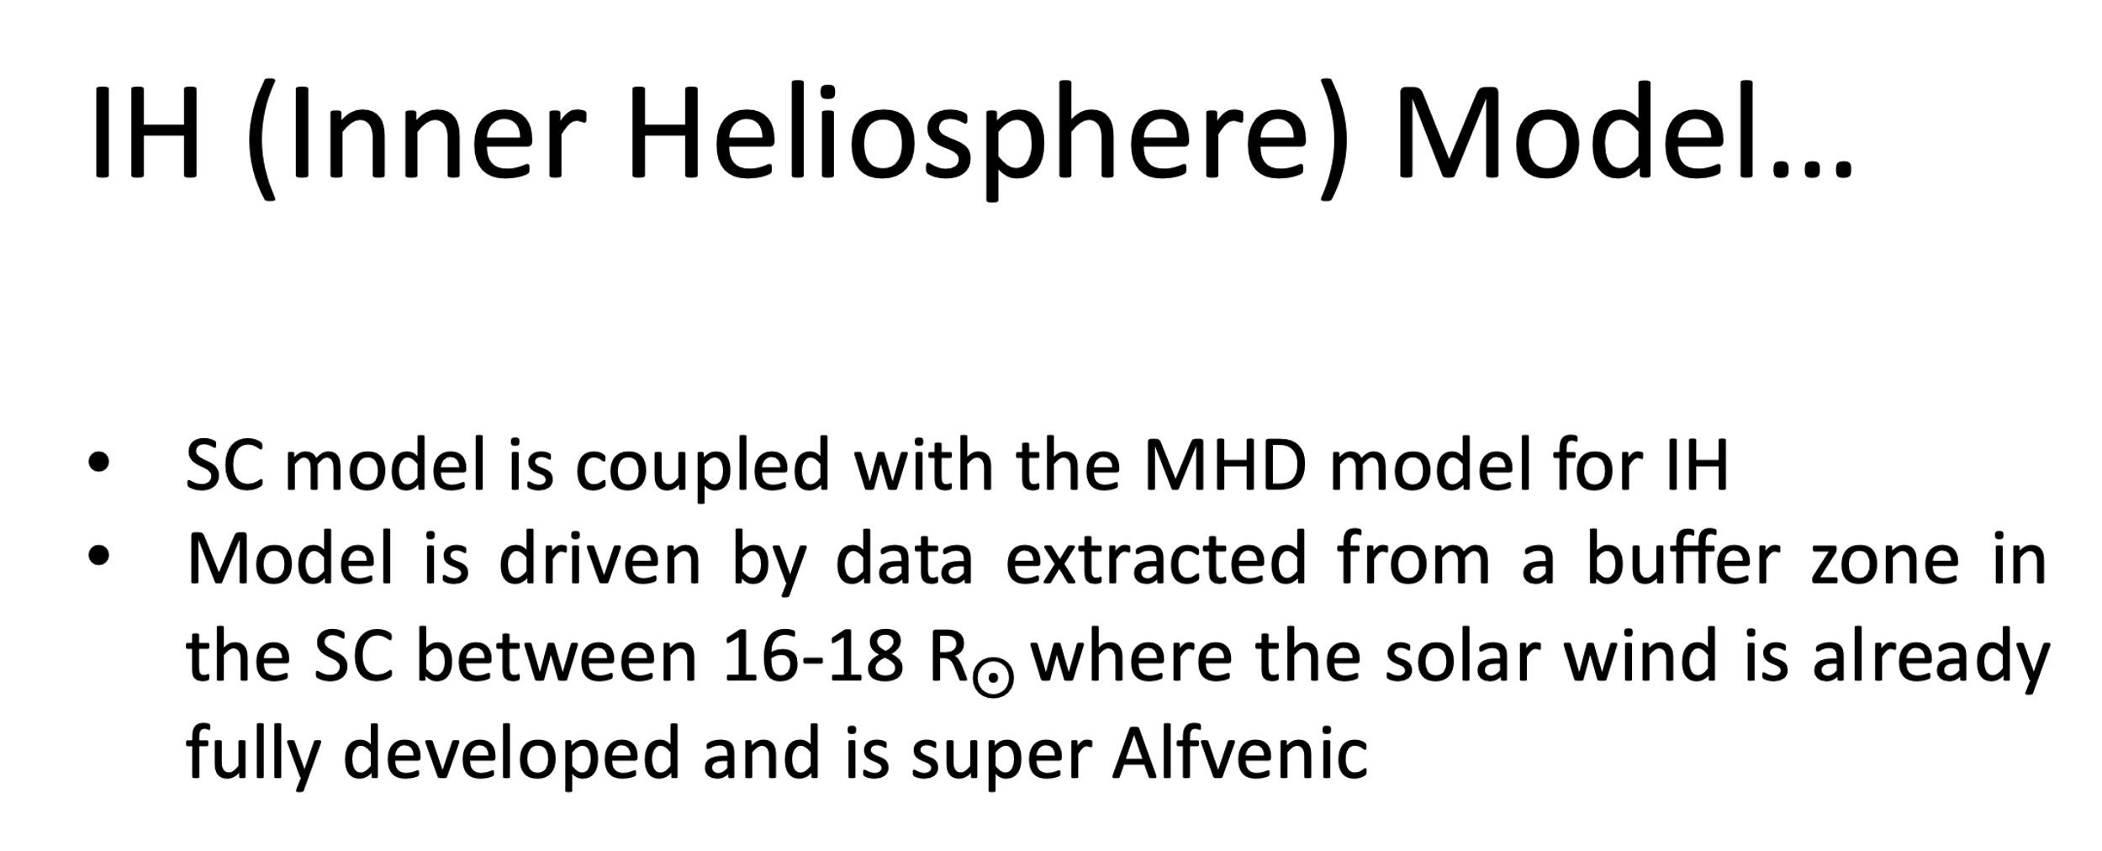

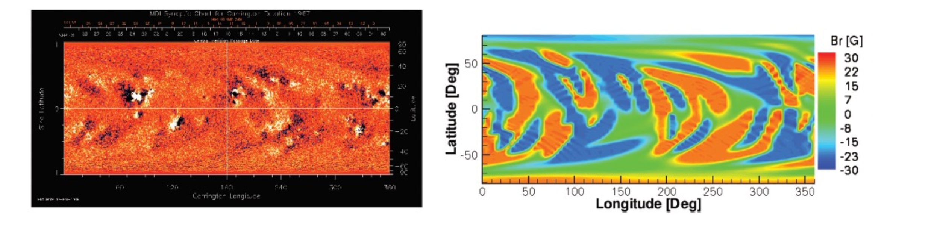
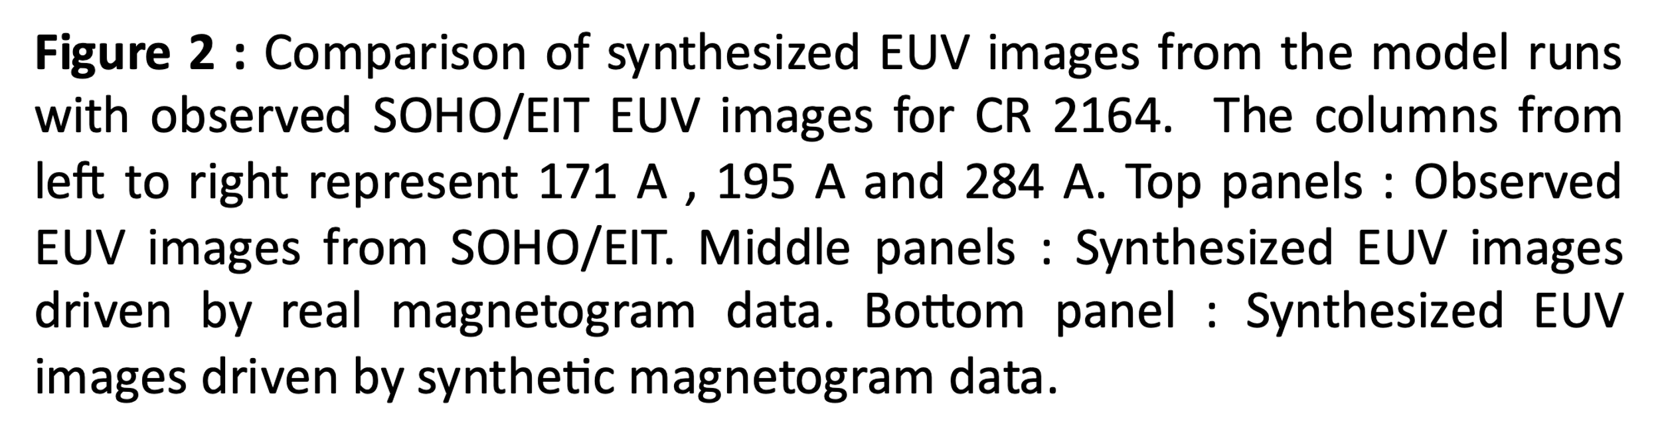
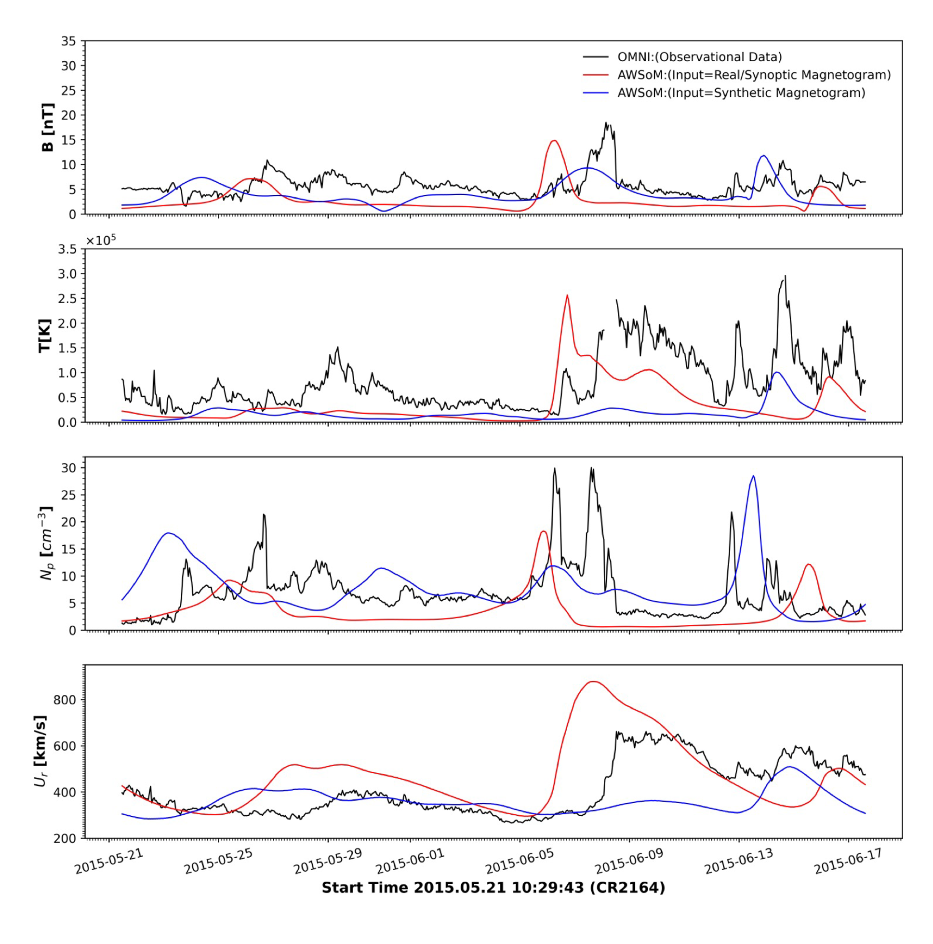
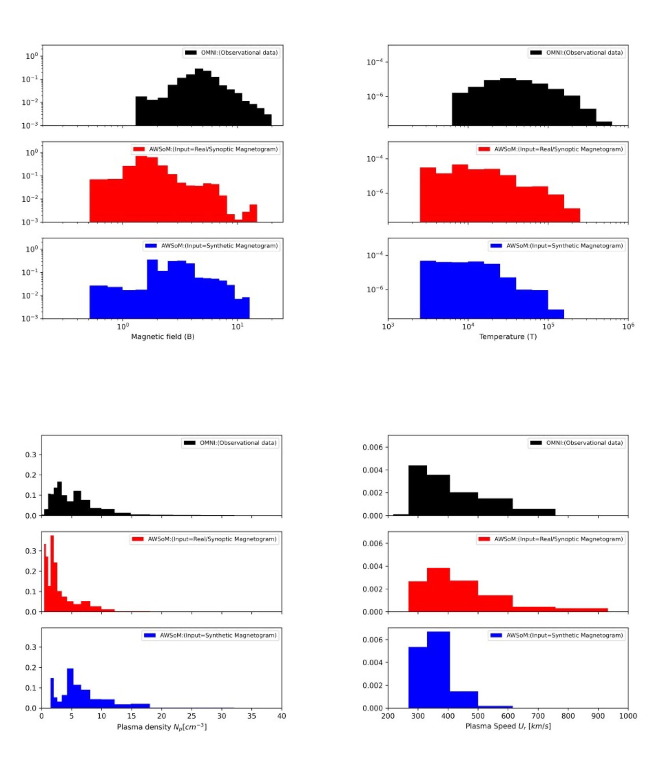
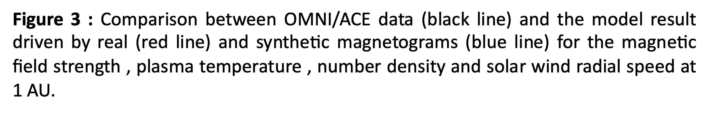
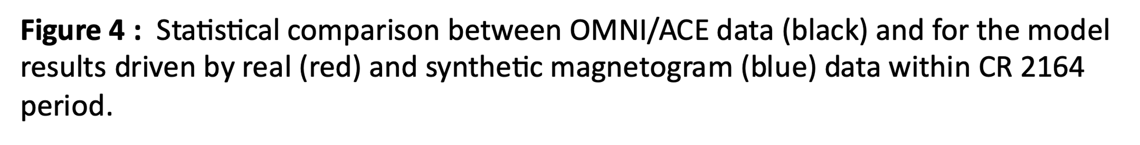
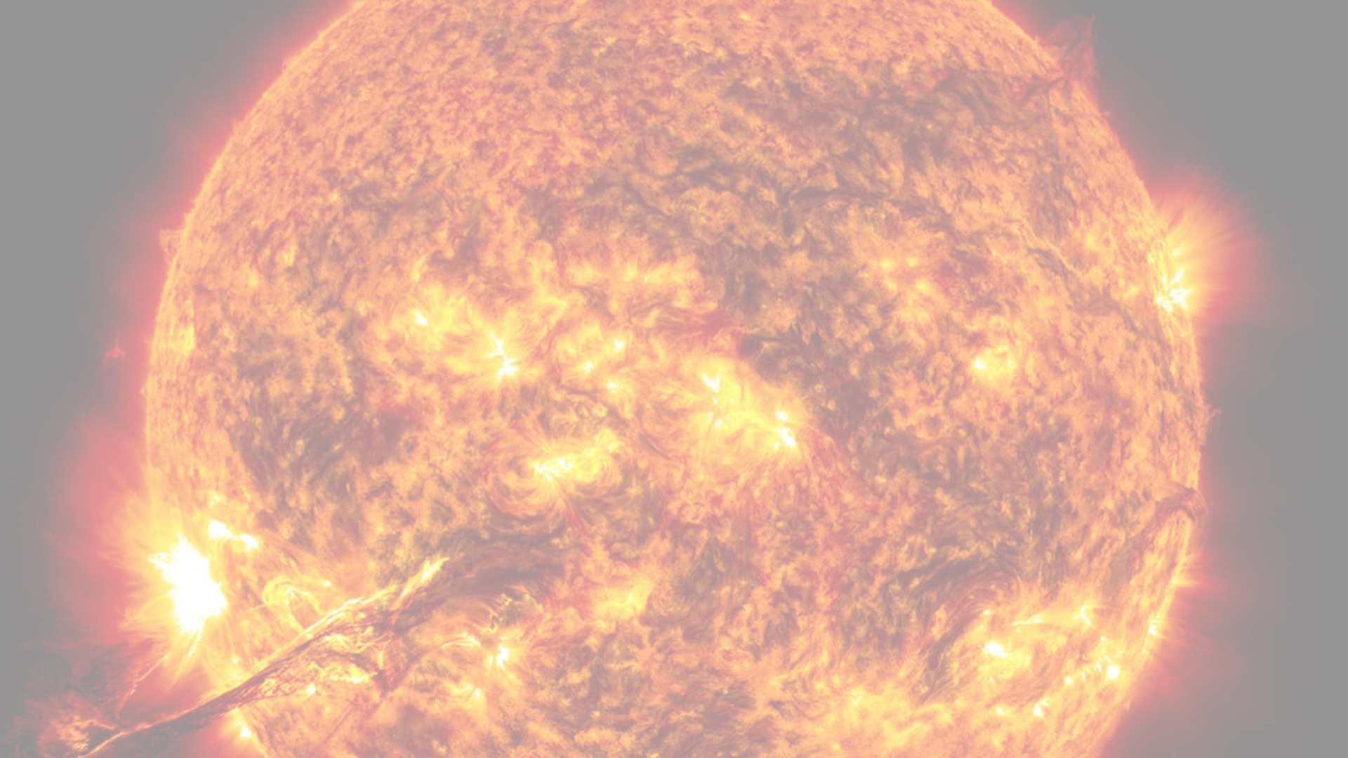
SIMULATING THE SOLAR WIND FROM THE SUN TO 1 AU USING SYNTHETIC MAGNETOGRAM DATA
Kalpa Henadhira Arachchige
Research Supervisor : Dr. Ofer Cohen
Department of Physics
University of Massachusetts Lowell
Model (Input)
Synoptic/real Magnetogram
data
Synthetic magnetogram
data

