Slide 1
Countermeasure Proposal to address [topic]
[Insert
company logo]
Presenter(s): Name 1, Name 2
Supporting Team Members: Name 1, Name 2, Name 3, Name 4

Slide 2
REMOVE THIS SLIDE
INSTRUCTIONS
Use this slide deck template to propose your Total Worker Health® countermeasures (interventions) to organizational leaders for approval and funding.
Use the tools and resources provided in the last slide to design countermeasures using a Total Worker Health approach.

Slide 3
REMOVE THIS SLIDE
GENERAL TIPS FOR PRESENTATION
Slides should only include key words and phrases (be short and to the point)
Use no more than 7 lines of text and 7 words per line (7X7 rule)
Use a large font size (above 22 pts)
Plan to present one slide per minute
Notes:
Additional recommendations:
-Check Presentation Planning Guide (HWPP manual IDEAS Step 5 – pages 181-184)
-Add talking points in the notes section of the slides
-Plan the presentation for 15-20 min + Q&A session

Slide 4
Outline
Introduction to HWPP and/or Lean program process
Background conditions
Current state
Proposal goal
Root cause analysis
Countermeasure options
Next steps

Slide 5
Lean Tools
Mapping connections between the HWPP and the Lean process
Lean Process
Form Program Teams
SC Formation
A3 Committee Selection
DT Formation
Design Team Start-up: Select first
issue
Background/Current Conditions
Kaizen Event
Root Cause Analysis
Value Stream Mapping
IDEAS Step 1: Identify root causes
Fishbone Diagram
Decision Analysis
IDEAS Step 2: Develop objectives
Problem Statement/Goal Selection
5 Why’s
IDEAS Step 3, 4, 5: Create Key
Performance Indicators and
Interventions
Countermeasure Selection
Standard Work
5 S’s
Failure Modes & Effects Analysis
IDEAS Step 6: Implementation
PDSA Cycle
Plan
Do
IDEAS Step 7: Evaluation
Evaluation
Study
Act
Notes:
Optional slide – use if it would be helpful to explain how the HWPP tools were used to supplement the Lean project

Slide 6
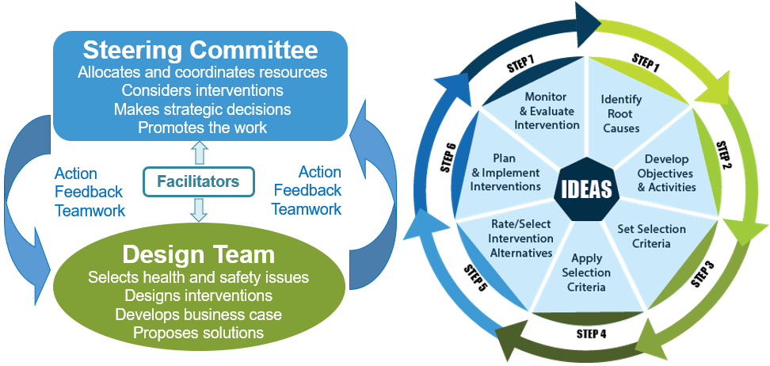
Program process
Formation of two committees
7-step IDEAS process to develop interventions
Healthy Workplace Participatory Program
Notes:
The Healthy Workplace Participatory Program (HWPP) involves a seven-step IDEAS process to build, implement and evaluate interventions. Each facility formed a Design Team of front-line workers and middle-level managers to analyze problems and develop solutions, with support from senior-level managers (the Steering Committee).

Slide 7
Program process
Main activities in the IDEAS process
Problem statement
Root cause analysis
Proposal goal and solution activities
Criteria for evaluating countermeasures (key performance indicators)
Development of countermeasure options (basic, comprehensive, hybrid)
Notes:
This slide shows the details of each step that the team accomplished as we prepared intervention alternatives.

Slide 8
Background conditions
Introduce the topic here. Give key stats about the “problem.”
Add more specific data related to a root cause here.
See samples in the notes below.
[Insert graphic of data (e.g., trends over months/years]
Notes:
Sample data points:
-Number of injuries in year(s) XX
-Percentage of worker absenteeism
-Average weekly hours of overtime
-Percentage of worker turnover
-Number of musculoskeletal disorders
-Cost of workers compensation claims
Sample description of background conditions:
-During FY12 - FY17, 35% of the employees’ lost time days were related to patient handling, resulting in $8,558,000 in incurred total costs (including Workers’ Compensation and staff replacement costs for lost days).
-In past year, 113 bariatric beds (i.e. beds used for patients weighing > 550lbs.) were rented with an average length of stay of 7.5 days (846 patient days).

Slide 9
Current state
Present info on current practice and costs here.
State the need for the new countermeasure.
See samples in the notes below.
Notes:
Sample description of current state:
-Current construction plans include the installation of a single motor ceiling lift per room, which will accommodate patients to a maximum weight of 550 lbs.
-Patients weighing over 550 lbs. will require manual lifting, boosting and repositioning; impacting patient safety, staff safety, quality of care, and patient satisfaction.
-The current investment in each single motor system installed is $10,000 per lift.
Sample description of the need for the new countermeasure:
-The facility is receiving more patients that exceed the limit of the lifting equipment currently being installed.
-Our staff continue to manually lift, boost or reposition patients vs. waiting for a portable lift, resulting in injury and lost time claims.

Slide 10
Proposal/Project goal
Major Health and Safety Objective
[Insert objective here]

Slide 11
Root cause analysis
[Insert fishbone diagram
(picture or electronic graphic)]

Slide 12
Root cause analysis
Sub-issue:
Issue 1
Sub-issue:
Issue 2
Sub-issue:
Issue 3
Contributing factors
Contributing factors
Contributing factors
Factor 1.1
Factor 1.2
Factor 1.3
Factor 2.1
Factor 2.2
Factor 2.3
Factor 3.1
Factor 3.2
Factor 3.3
Notes:
Use this slide to focus on main sub-issues from the fishbone diagram

Slide 13
Key performance indicators for countermeasures
Short term outcomes
Short term goal 1
Short term goal 2
Short term goal 3
Long term outcomes
Long term goal 1
Long term goal 2
Long term goal 3

Slide 14
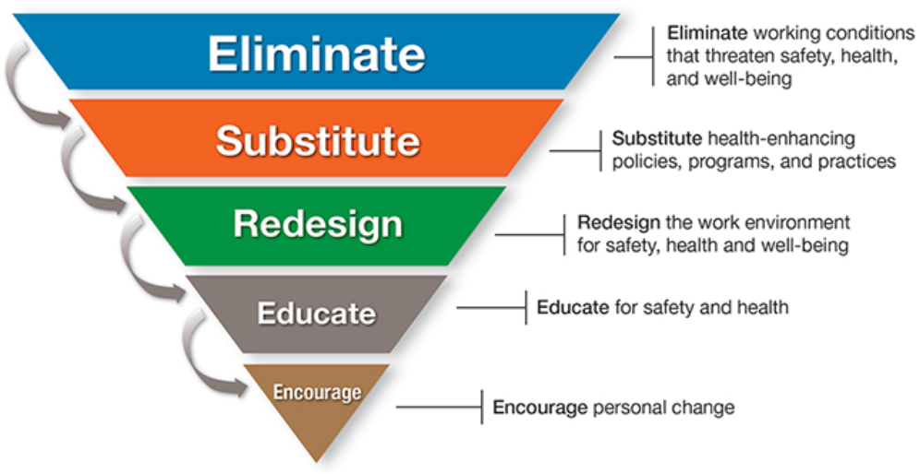
Qualities of integrated countermeasures
Key features that improve impact
Address work and non-work contributing factors
Address change at multiple levels: work organization and individual
Most effective
Least effective
Work organization level
Effectiveness
Individual level
Notes:
This slide sets the stage for talking about the countermeasure options.
Key messages:
Using a Total Worker Health approach means addressing a problem as completely as possible by intervening to address multiple root causes. This kind of multi-layered, integrated approach has the best chance for success.
It is most effective to focus resources on countermeasures that remove hazards from the work flow. Focusing efforts at the work organization level is more sustainable and benefits greater numbers of workers in the long run.
It is less effective to invest in countermeasures that encourage changes at the individual level. That is because behavior is very difficult to change; it is subject to complex decision making and continuous training is needed for motivation and educating new staff.

Slide 15
Countermeasure options
Three countermeasure alternatives
Basic level: Minimum activities required to achieve a meaningful positive impact.
Comprehensive level: Ideal set of activities to achieve maximum positive impact
Mid level: Selected activities between the Basic and Comprehensive countermeasure options.
Notes:
When developing TWH countermeasures to a Health and Safety problem, different alternatives can be used depending on resources available.
This way, decision makers can select the option that is in line with available resources AND acknowledges appropriate outcomes for each level.
-Mid level is a hybrid countermeasure in between (midway) the basic and comprehensive levels.
-Each level should have integrated countermeasures that promotes safety and wellbeing at work and individual levels.

Slide 16
Option 1
Basic level countermeasure
Activity 1
Activity 2
Activity 3
Activity 4
Activity 5
Notes:
Describe countermeasure – Basic level – here, listing all the activities involved

Slide 17
Option 2
Comprehensive level countermeasure
Basic countermeasure +
Activity 6
Activity 7
Activity 8
Activity 9
Activity 10
Notes:
Describe countermeasure – Comprehensive level – here, listing all the activities involved

Slide 18
Option 3
Mid level countermeasure
Activity 1
Activity 5
Activity 9
Activity 10
Notes:
Describe countermeasure – mid level – here, listing all the activities involved (a “hybrid” model involving a blend of Basic and Comprehensive option activities)

Slide 19
Countermeasure options
Basic | Comprehensive | Mid level
Activity 1 Activity 2 Activity 3 Activity 4 Activity 5 | Basic countermeasure + Activity 6 Activity 7 Activity 8 Activity 9 Activity 10 | Activity 1 Activity 5 Activity 9 Activity 10
Notes:
This page is intended to prove an “at a glance” view

Slide 20
Countermeasure options
Basic | Comprehensive | Mid level
Pros Low resources needed Pro 2 (fill here) Cons Minimum meaningful positive impact Con 2 (fill here) | Pros Maximum positive impact Pro 2 (fill here) Cons High resources needed Con 2 (fill here) | Pros Meaningful positive impact Pro 2 (fill here) Cons Medium/high resources needed Con 2 (fill here)

Slide 21
Next steps
Steering Committee (SC) rates countermeasure options.
SC selects a countermeasure within [to be negotiated (e.g., 30 days)].
SC collaborates with Design Team in countermeasure implementation.
Design Team starts a new IDEAS process cycle.

Slide 22
OPTIONAL RESOURCES
Healthy Workplace Participatory Program main page
www.uml.edu/cphnewtoolkit
Participatory Program Tools
Form Program Teams
https://www.uml.edu/Research/CPH-NEW/Healthy-Work-Participatory-Program/Form-Program-Teams/
Design Team Start-up Guide
https://www.uml.edu/Research/CPH-NEW/Healthy-Work-Participatory-Program/form-design-team/
Intervention Design and Analysis Scorecard (IDEAS) Tool
https://www.uml.edu/Research/CPH-NEW/Healthy-Work-Participatory-Program/generate-solutions/
Developed by the Center for the Promotion of Health in the New England Workplace with support from NIOSH grant #U19‐OH008857, 2022. Total Worker Health® is a registered trademark of the U.S. Department of Health and Human Services (HHS). Participation by CPH-NEW does not imply endorsement by HHS, the Centers for Disease Control and Prevention, or the National Institute for Occupational Safety and Health (NIOSH).

